Slide 1
Leveraging Textual Specifications for Grammar-based Fuzzing of Network Protocols
Samuel Jero, Maria Leonor Pacheco, Dan Goldwasser, Cristina Nita-Rotaru

Slide 2
Motivation
Network protocol implementations have a long history of bugs and attacks
Testing protocol implementations by injecting packets
Grammar-based Fuzzing - Use the protocol logic when injecting packets
A case for NLP - It requires a big manual effort to work correctly
Can we automate it?
Notes:
Computer networks are at the center of most -if not all- modern applications. There are thousands of different network protocol implementations, they are complex, highly optimized and with a long history of implementation bugs and attacks. Protocol fuzzing is among the techniques that have come up to test these protocols. The main idea behind fuzzing is to generate and inject packets into the protocol stream to find bugs and other vulnerabilities. For this method to be successful, the generated packets need to be crafted carefully. With this in mind, grammar-based fuzzing attempts to generae attacks based on a grammar that encodes protocol semantics. The main drawback of this method, is that it equires a lot of manual effort, reading all specification documents and providing the input. The main goal of our work, is to try to automate this process by relying on NLP techniques

Slide 3
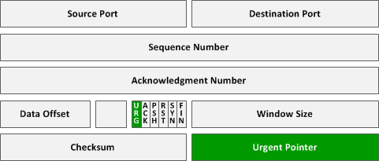
Grammar-based
Fuzzing
Example
TCP Packet Header
A TCP Packet contains a checksum of the rest of the header.
To test other vulnerabilities, we need to pass the checksum check.

Slide 4
Manual Grammar Extraction
Effectiveness fuzzing depends on correctly capturing the protocol logic
Different protocols have different logic
Manual effort to specify protocol grammar
Untapped resource - Natural language specification documents (RFCs)
Two Goals:
Minimize manual effort used
Adapt to new protocols without re-training

Slide 5
Automating Grammar Extraction
A grammar is composed of a set of fields that correspond to the header and properties associated to those fields.
We identify two NLP problems:
Type Extraction - Given a protocol document, extract the set of protocol field and property symbols
Symbol Identification and Linking - Identify mentions of these symbols in text, and link field mentions to their relevant properties.

Slide 6
Zero-Shot Learning for Symbol Identification
A fully supervised approach would require a separate classifier for each protocol Chunk->Type of Mention
ZSL approach - learn a mapping {Type T, Chunk} -> {t,f} from a tuple containing input and output to a Boolean value indicating whether the pair is correct.
Learn a similarity function between textual phrases and protocol symbols. This approach adapts to new, unseen protocols.

Slide 7
Example of ZSL approach for field mentions
(This field, Source Port)
Chunked Text: [This field] [is] [only] [be interpreted] [in] [segments] [with] [the URG control bit set]
Protocol Field Symbols:
Source Port
Destination Port
…
Checksum
Urgent Pointer
Options
(This field, Dest. Port)
(This field, Checksum)
(This field, Urgent Pointer)
(This field, Options)

Slide 8
System Design
Pre- process
Extract Types
Train Classifier
Model
Training
TCP, SCTP,
IPv6, IP, GRE
Pre- process
Extract Types
Model
Post-
process
Fuzzer
DCCP
Protocol Grammar

Slide 9
Extraction Example
[The offset] from the start of the packet’s DCCP [header] to the start of its application data area, in 32-bit words .
Extract: Header_Length(Data_Offset)

Slide 10
Intrinsic Evaluation: Information Extraction
Our Approach: Linear classifier that learns a similarity metric between text chunks and symbol types, considering character-level similarity, writing style, context words, etc.
Baselines:
Overlap between symbol types and text chunks
Rule based systems that use our feature set
RB1: weight each feature by frequency of occurrence
RB2: weight each feature by majority vote

Slide 11
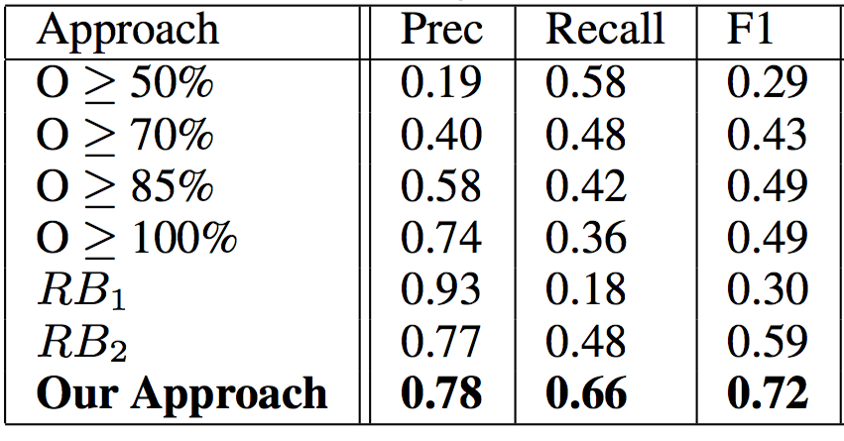
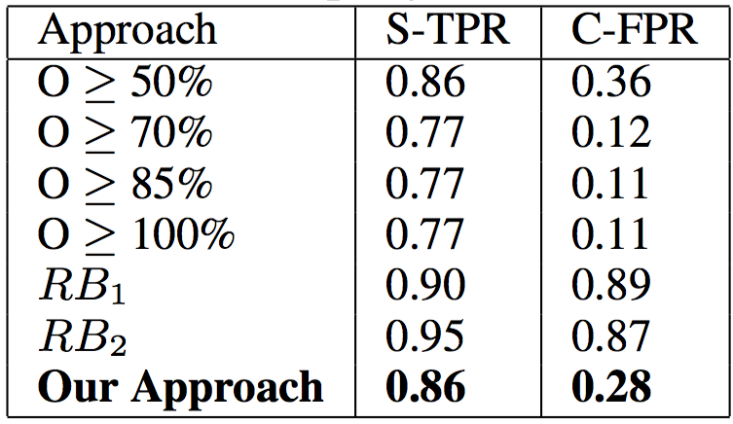
Intrinsic Evaluation: Information Extraction
Table 1: Field Mentions
Table 2: Property Mentions
Properties can span several chunks
* S-TPR: Span true positive rate
* C-FPR: Chunk false positive rate
Notes:
Tradeoff in overlap systems is very clear:
The higher the degree of overlap, the highest the precision, and the lower the recall.
As we become more permissive, recall increases but precisions suffers.
We can attibute this to the fact that only certain features are going to be good indicators, depending on the case. For this reason, we can benefit from a classifier.

Slide 12
Extrinsic Evaluation: Fuzzer
Use an NLP pipeline to extract protocol grammars on a real scenario
SNAKE: State-of-the-art grammar-based fuzzer for network transport protocols
Evaluated Approaches:
Random: no information about the protocol grammar
Manual: manually created protocol grammar
NLP-based: automatically extracted protocol grammar

Slide 13
Extrinsic Evaluation: SNAKE Fuzzer
 | TCP |  |  |  | DCCP
 | Unique Pkt Type Traces | Total Strategies | Interesting Attacks | Unique Attacks | Unique Pkt Type Traces | Total Strategies | Interesting Attacks | Unique Attacks
Random | 13 | 1000 | 0 | 0 | 18 | 1000 | 0 | 0
Manual | 784 | 901 | 63 | 5 | 718 | 871 | 44 | 2
NLP | 713 | 819 | 69 | 5 | 816 | 1022 | 47 | 2
Notes:
Effort (blue) -- Random vs Knowledge Generated attacks (orange) -- Manual vs NLP
A packet type trace records the order in which different types of packets are observed in a flow. Thus, a packet type trace succinctly summarizes a protocol connection and approximates the path traversed through the code.
To effectively test a protocol, as many unique connections, or code paths, as possible should be explored.
--- the next two metrics that we show correspond to the generated attacks. There are a number of attacks that we consider irrelevant for these protocols, given that TCP and DCCP do not attempt to protect against them. For this reason, we focus on the number of off-path or interesting attacks generated. From all of these attacks, many attempt to test the same underlying vulnerability. For this reason, we perform a manual analysis of all reported attacks and identify the number of unique attacks generated.

Slide 14
Summary and Conclusions
Proposed a methodology for Information Extraction from technical documents using domain adaptation and minimal supervision
Built an NLP framework to extract grammars from natural language specification documents and combined it with a state-of-the-art grammar-based fuzzer
We compared our extracted grammar to manual grammars on two protocols and identified the same set of unique attacks in a fully automated manner.
Promising research direction to achieve effective automated testing
Notes:
We find this to be a promising direction to generalize testing strategies that reduce manual effort.

Slide 15
Thank You

