Slide 1
Leveraging State Information for Automated Attack Discovery In Transport Protocol Implementations
Samuel Jero, Hyojeong Lee, and Cristina Nita-Rotaru
Purdue University
DSN 2015

Slide 2
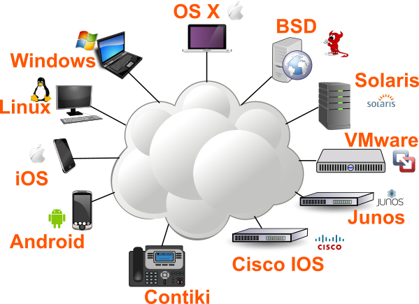
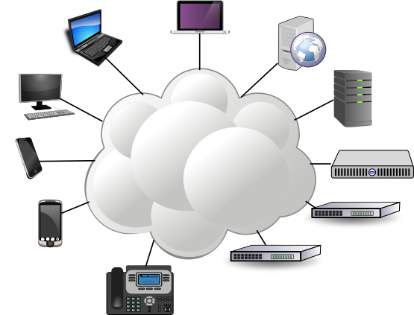
Transport Protocols
Critical to today’s Internet
  Used by many applications
  Underlie secure protocols like TLS
  Underlie network infrastructure protocols like BGP
Numerous implementations
  Over 3,000 implementation variants detectable by nmap

Slide 3
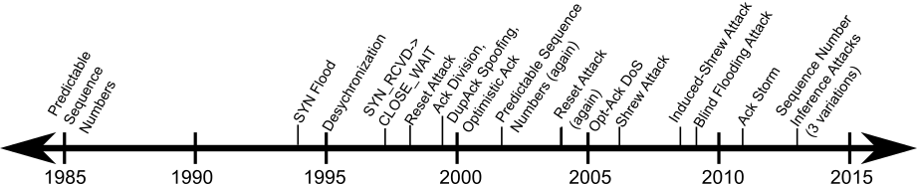
TCP Attacked for 30 years!

Slide 4
Why So Many Attacks?
Many designs and implementations
  Multiple variations, especially of congestion control
    Tahoe, Reno, New Reno, SACK, Vegas, BIC, CUBIC, others
  Over 20 RFCs defining variations or features
  Hundreds of implementations
Complex goals
  Reliability, in-order delivery, congestion control, others
Written in low level languages, part of OS
  Error-prone, but highly efficient
Heavily optimized
  Prefer performance to ease of understanding and maintenance

Slide 5
Current Testing Methods
Developer test suites
  Tests used by developer to make sure implementation is correct
  Packetdrill [USENIX 13]
Fuzzing
  KiF [IPTComm 07], SNOOZE [ISC 06], EXT-NSFM [IMCCC 11]
  Find crashes by subjecting implementation to random inputs
MAX [SIGCOMM 11]
  Automatically find manipulation attacks using symbolic execution
Turret [ICDCS 14]
  Find performance attacks on distributed systems using greedy message modification
Ad-hoc, focused on benign scenarios
Unable to cover entire protocol, difficulty reaching deep states
Requires the user to select vulnerable lines of code
Only focused on performance attacks, difficulty with transport protocols
Notes:
How can we test diverse transport protocol implementations in a systematic and automated manner?

Slide 6
Our Approach
SNAKE: State-based Network AttacK Explorer
Tests unmodified implementations
Uses message-based attacks
Finds performance, fairness, and resource exhaustion attacks
Uses protocol state machine to enable efficient, systematic testing
Found 5 new and 4 known attacks
  5 protocol implementations
  2 protocols
  4 operating systems

Slide 7

Outline
Motivation
Transport Protocols
SNAKE: Design and Implementation
Evaluation and Results
Summary

Slide 8
Transport Protocols
Responsible for end-to-end communication
Provide guarantees to applications
  Reliability
  In-order delivery
  Flow control
  Congestion control
  Fairness
Connection oriented to maintain state
  Connection establishment
  Data transfer
  Connection tear down
There are more than 13 RFCs dealing with TCP Congestion Control alone!

Slide 9
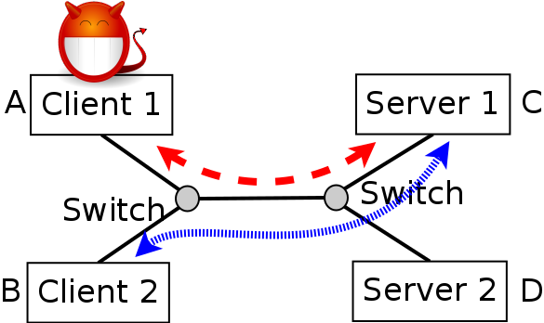
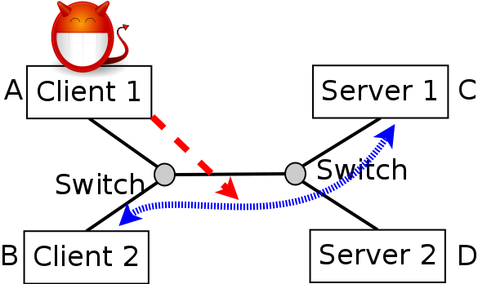
Attacker Model
Malicious Clients
Off-path Attackers
Resource exhaustion attacks
Fairness attacks
Connection establishment attacks
Throughput degradation attacks

Slide 10
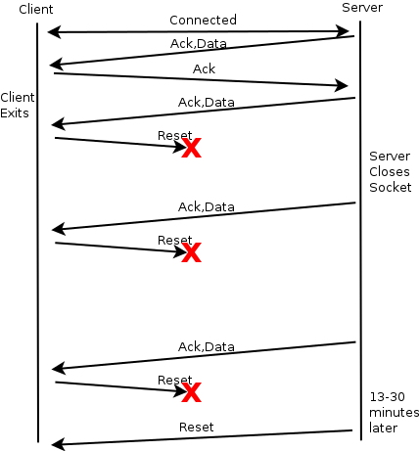
TCP CLOSE_WAIT Resource Exhaustion Attack
Client can force server to keep socket state around for 13-30 minutes
Client application exits
Client responds to all future data with Resets
Resets are dropped
Server must receive ACKs for all data before it can close connection

Slide 11
How Do We Find Attacks?
Attack injection scheme
Identify points where message-based attacks could be inserted into a test scenario
Impacts the practicality and effectiveness of the testing
  Practicality: Systematic, exhaustive testing should test all attack injection points
  Effectiveness: Testing can only find vulnerabilities that occur at attack injection points

Slide 12
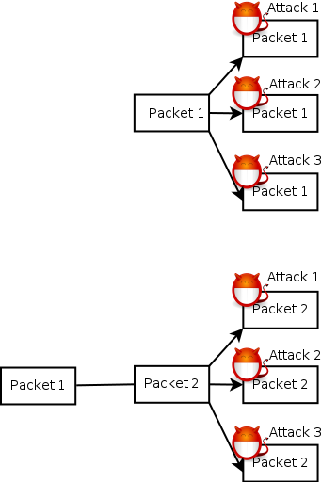
Packet-Send-based Attack Injection
For each packet, inject each message attack at packet send
Pros
  Simple
  Systematic
Cons
  Does not support injecting new packets
    No support for off-path attacks
  Only considers modifying a single packet per test
Not Scalable!
Scales with packets * attacks
Our two minute TCP tests generate about 13,000 packets
13,000 pkts * 53 attacks * 2 min = 22,967 hours = 956 days
Misses Attacks!
Unable to find off-path attacks

Slide 13
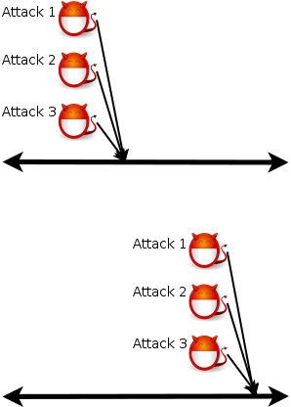
Time-based Attack Injection
Every n seconds, inject each message attack and observe the result
  n represents a trade off between scalability and coverage
  Minimum n is the time to transmit a minimum sized packet
Pros
  Supports injecting new packets
Cons
  Only considers applying a single attack per test
Cannot Achieve Scalability and Coverage!
Scales with n*connection_length*attacks
A minimum sized TCP packet takes 5 microseconds to transmit at 100Mbits/sec
12 million pkts*60 attacks*2min = 24 million hours

Slide 14
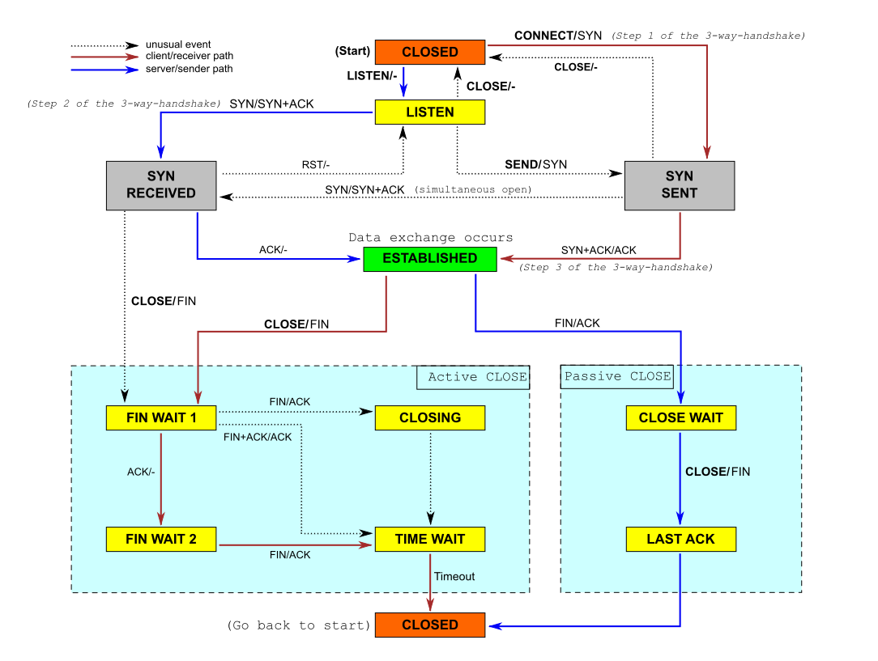
Protocol State Machine Attack Injection
Improved scalability and coverage
State machine identifies key protocol areas
Similar packet types received in the same state often perform similar actions
Combine protocol state and packet type for attack injection
TCP State Machine

Slide 15
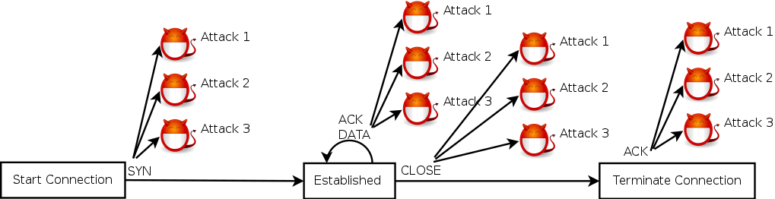
Protocol State Machine Attack Injection
Consider the protocol state, packet type pairs and apply each message attack to each pair
Pros
  Scalable---About 300 hours to test an implementation
  Can apply attacks to more than a single packet
Cons
  Assumes state machine is available
  Assumes state machine is implemented correctly

Slide 16
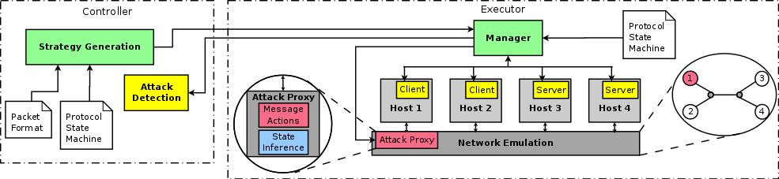
SNAKE
Virtual machines running unmodified implementations with an emulated network
A malicious proxy in front of one VM performs attack injection
  Supported message attacks: Drop, Duplicate, Delay, Batch, Reflect, Lie about packet fields, Inject, and HitSeqWindow
Current protocol state tracked by monitoring packets

Slide 17
SNAKE
During testing, performance and resource usage information is collected to identify attacks
Attack declared successful if:
  Throughput of a flow is above or below that of the competing flow’s by more than a factor of 2
  Server resources are not released at the end of the test

Slide 18
Evaluation
Two transport protocols
TCP
DCCP
Five implementations in four operating systems:
Linux 3.0/Linux 3.13
Windows 95/Windows 8.1
Strategies tested:
TCP: 5,500
DCCP: 4,500
Testing time per implementation:
About 60 hours
Found 9 vulnerabilities, 5 of them unknown

Slide 19
Results Summary
Protocol | Attack | Impact | OS | Known
TCP | CLOSE_WAIT Resource Exhaustion | Server DoS | Linux 3.0/3.13 | Partially
TCP | Packets with Invalid Flags | Fingerprinting | Linux 3.0 / Win 8.1 | No
TCP | Duplicate Ack Spoofing | Poor Fairness | Win 95 | Yes
TCP | Reset Attack | Client DoS | All | Yes
TCP | SYN-Reset Attack | Client DoS | All | Yes
TCP | Duplicate Ack Rate Limiting | Degraded Throughput | Win 8.1 | No
DCCP | Ack Mung Resource Exhaustion | Server DoS | Linux 3.13 | No
DCCP | In-window Ack Sequence Number Modification | Degraded Throughput | Linux 3.13 | No
DCCP | REQUEST Connection Termination | Client DoS | Linux 3.13 | No

Slide 20
Summary
We propose a new, efficient technique for automated, systematic testing of transport protocol implementations based on the protocol’s state machine
We have implemented this technique in SNAKE and applied it to 5 implementations of 2 transport protocols in 4 operating systems
We found 9 attacks, 5 of which are unknown

Slide 21
Questions?

