Slide 1
Dynamic Control of Real-Time Communication (RTC) using SDN:
A case study of a 5G end-to-end service
Samuel Jero, Vijay K. Gurbani, Ray Miller, Bruce Cilli,
Charles Payette, Sameer Sharma
Purdue University and Nokia Bell Laboratories
NOMS 2016

Slide 2
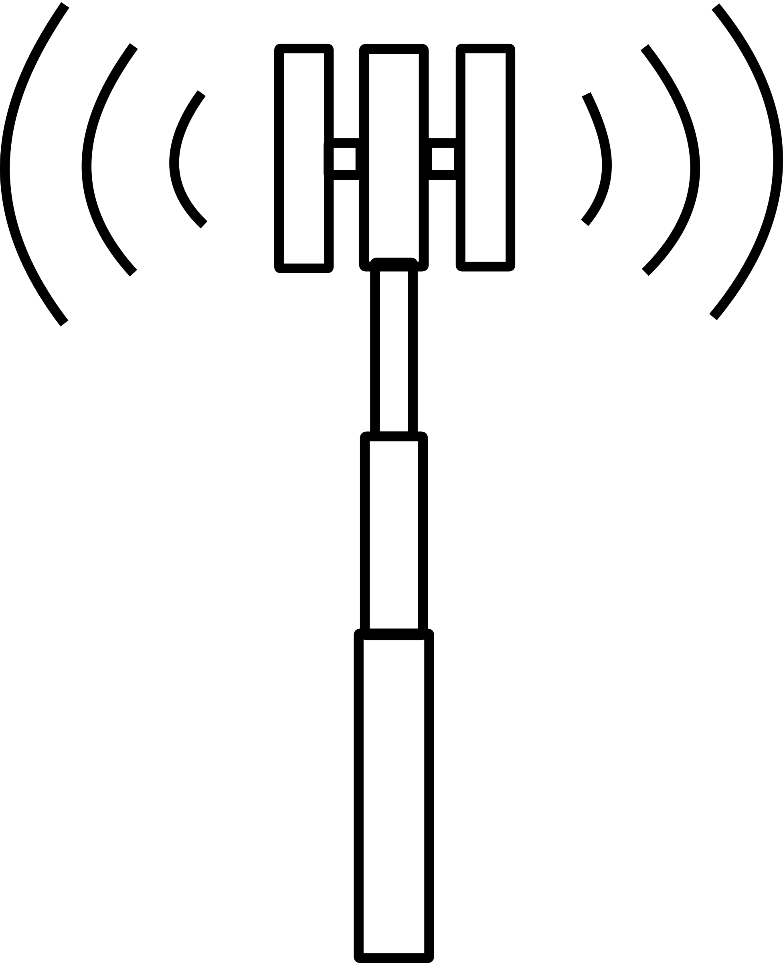
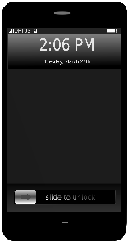
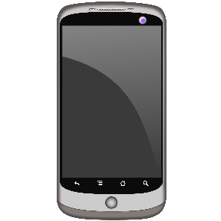
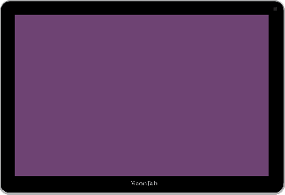
Mobile Networks
Faster, better connections than ever before
Demand for bandwidth and connectivity continues to grow
  69% increase in 2014
  560% increase by 2017
Drivers: streaming video, interactive video sessions, data center applications, tactile internet

Slide 3
5G: The Next Generation Mobile Network
Greatly increased range of applications and requirements
  Devices: Power-limited sensors, smart phones, tablets, virtual reality, cars, industrial applications, and others
  Data Rates: sensor data to 8K UHD video
  Latency: down to sub-millisecond
  Packet Sizes: tinygrams to jumbograms
Key Trends:
Network performance indicators will include higher level QoE
The network should adapt to the application, not the other way around
Flexibility and adaptability are key!

Slide 4
Our Vision of the 5G Architecture
Application /
Business Layer
Enterprises
Tenants
Service Providers
Analytics
Subscribers
Services Layer
Services
Network Slices
Orchestration
Layer
Management and
Orchestration
NF-graphs
NFV
Control Layer
SDN
Infrastructure
Layer
Access Technology
Core Network
Commodity Compute
SDN and NFV are be key enablers

Slide 5
SDN
Centralized control of the network
Separation of the Data and Control planes
DNE-RTC
SDN Apps
Low Latency
Device to Device
Application-plane
Northbound API
Controller
SDN Controller
SDN Controller
SDN Controller
Control-plane
Southbound API
Switch
Switch
Devices
eNodeB
Switch
Data-plane
Compute
Compute

Slide 6
Our Work
Understand the interactions between the network and dynamic services
  Dynamic services: services that demand a wide variability in network bandwidth and expectations
Approximate a 5G network by introducing an SDN controller into a 4G/LTE testbed
Consider an case study dynamic network service: DNE-RTC
Identify key takeaways for the design of 5G

Slide 7

Outline
Motivation
5G Architecture
OTT-RTC and NE-RTC
DNE-RTC: a dynamic
network service
The 4G/LTE Network
Our proof of concept Implementation
Takeaways

Slide 8

OTT-RTC and NE-RTC
Network enabled webRTC
(NE-RTC)
webRTC is an OTT service that allows real-time communications between users over the Internet
No plugins, no apps
Poor video quality and/or extreme latency at sub-100kbps rates
Unfair competition: devices in similar network conditions may have rates that differ by > 2x
Cell load changes impact random users
Network service developed by Bell Labs to provide improved, consistent video call quality
Calculates target bitrate for video flows on base station based on SINRs and number of users
Provides feedback to device about target bitrate
Special radio scheduling algorithm designed for guaranteed bitrate flows
Allocates resources across the network to provide desired bitrate
Image: https://xenforo.com/community/threads/looking-for-a-webrtc-developer-for-an-open-voice-stream-chatroom.91304/

Slide 9
Dynamic Network Enabled RTC (DNE-RTC)
Dynamically enable NE-RTC only when it will be useful for video calls currently in progress
  Limiting usage of resources to only those times and calls that will benefit
  Key character of an adaptable network, like 5G
DNE-RTC App running on SDN Controller receives device metrics from analytics
NE-RTC enabled/disabled based on metrics indicating its usefulness
DNE-RTC App
= Analytics
Call Start/Stop
SDN Controller
Setup
QoS
Target Bitrate
Device Metrics & eNodeB ctrl
v-WebRTC Gateway
Routing & QoS
Device
v-eNB
Switch
Switch
Device
RTP and RTCP

Slide 10
The 4G/LTE Network
Since no 5G testbeds exist yet, we base our proof of concept on a 4G/LTE testbed
The 4G/LTE Network consists of a number of interacting components:
  eNB (eNodeB) or radio base station
  SGW (Serving Gateway) –establishes bearers for data flows
  PGW (Packet Gateway) –policy enforcement and packet routing
  MME (Mobility Management Entity) –key mobility control node
  PCRF (Policy and Charging Function)—sets network policy
  HSS (Home Subscriber Server)
HSS
Control-plane
Data-plane
Video Traffic
PCRF
WebRTC Gateway
MME
Device
eNB
SGW
PGW
Device
RTP and RTCP

Slide 11
Our Proof of Concept 5G Network
We simulate a 5G network by introducing an SDN controller into a 4G/LTE testbed
An OpenFlow adaptor enables SDN Controller to control the eNodeB
  Adaptor maps between OpenFlow and the base station’s CLI commands
  Sends device throughput info to controller and enables/disables NE-RTC
DNE-RTC App
New control-plane
Existing control-plane
Data-plane
Video Traffic
SDN
Controller
Call Start/Stop
UEID mapping
Device info & ctrl
Setup
GBR bearers
Video
bitrate cap
HSS
OpenFlow
Adaptor
OpenFlow
PCRF
WebRTC Gateway
MME
Device
eNB
SGW
PGW
Device
RTP and RTCP

Slide 12
Our Proof of Concept 5G Network
DNE-RTC app runs on SDN controller and uses device throughput to decide when to enable or disable NE-RTC
App communicates with many existing components:
  MME to map between different device identifiers
  PCRF to setup guaranteed bitrate bearers for video flows
  WebRTC gateway to set target bitrates
  Device to determine when a call is occurring
DNE-RTC App
New control-plane
Existing control-plane
Data-plane
Video Traffic
SDN
Controller
Call Start/Stop
UEID mapping
Device info & ctrl
Setup
GBR bearers
Video
bitrate cap
HSS
OpenFlow
Adaptor
OpenFlow
PCRF
WebRTC Gateway
MME
Device
eNB
SGW
PGW
Device
RTP and RTCP

Slide 13
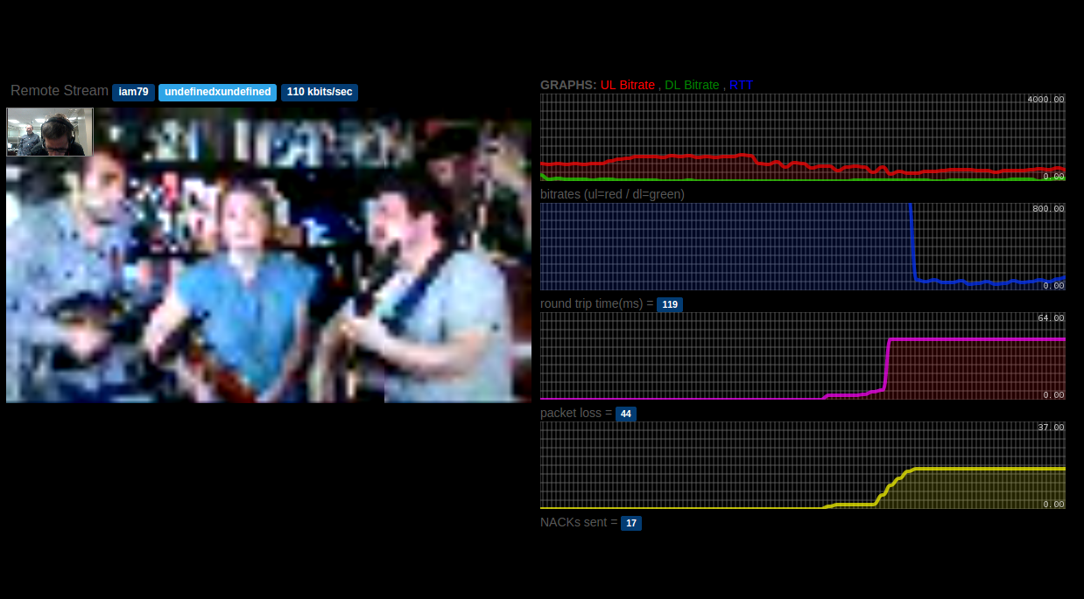
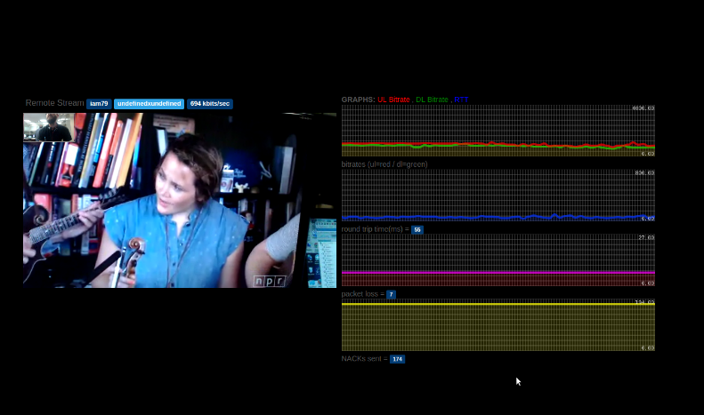
DNE-RTC App
Computes an exponentially weighted moving average of each device’s throughput
NE-RTC is enabled when the device is in a call and its throughput drops below a low threshold
  Enables target bitrate computation and scheduling algorithm
  Sends target bitrate info to WebRTC gateway
  Sets up guaranteed bitrate bearers across the network
A second higher threshold determines when to disable NE-RTC again
  Disables target bitrate computation and scheduling algorithm
  Releases guaranteed bitrate bearers for this flow

Slide 14
Horizontal SDN interactions are common
Mobile Networks are usually separated into a number of domains: RAN, Edge, and Core
Network services need to frequently communicate and configure components across all of these domains
  RAN: base station throughput info and scheduling algorithm
  Edge/Core: guaranteed bitrate bearers
  App: target bitrate
Thus horizontal communication between controllers in different domains MUST be efficient
RAN
Edge
Core
Services

Slide 15
Identifier proliferation complicates services
The existing 4G/LTE network components use many different identifiers for the same device
  IMSI, S1APID, IP address, SIP URI
Implementing the DNE-RTC service required mapping between 4 of these
  Hardest part of the implementation
Need to minimize the number of identifiers needed in 5G service APIs and enable easy mapping
  The centralized information and control of SDN will help here
IP: 203.0.113.15
IMSI: 241100754492889
S1APID: 0x57143
SIP: bob@example.com

Slide 16
Network function graphs have control plane elements
Network function graphs provide a way to define services in terms of connected network elements
  Being standardized by ETSI and IRTF
Usually discussed in terms of data plane elements
  Firewalls, load balancers, IPS, IDS, etc
These graphs need to be able to include control plane elements in addition to data plane elements
  The new components in DNE-RTC are control plane
Best Effort Network Function Graph:
DNE-RTC Network Function Graph:
Device
eNB
WebRTC Gateway
Internet
DNE-RTC
Controller
Device
eNB
WebRTC Gateway
Internet

Slide 17
Summary
We developed a proof of concept dynamic network service by introducing an SDN controller into a 4G/LTE testbed to study the dynamics of network and service interactions
We identified three key takeaways for future work in 5G
  Horizontal SDN-controller interactions are common
  Identifier proliferation complicates service development
  Network function graphs need to be able to contain control plane elements

Slide 18
Questions?
?? || /* */

