Slide 1



BEADS: Automated Attack Discovery in OpenFlow-based SDNs
Samuel Jero¹, Xiangyu Bu¹, Cristina Nita-Rotaru², Hamed Okhravi³,
Richard Skowyra³, and Sonia Fahmy¹
¹Purdue University, ²Northeastern University,
and ³MIT Lincoln Laboratory
RAID 2017
DISTRIBUTION STATEMENT A. Approved for public release: distribution unlimited. This material is based upon work supported by the Department of Defense under Air Force Contract No. FA8721-05-C-0002 and/or FA8702-15-D-0001. Any opinions, findings, conclusions or recommendations expressed in this material are those of the author(s) and do not necessarily reflect the views of the Department of Defense.© 2017 Massachusetts Institute of Technology. Delivered to the U.S. Government with Unlimited Rights, as defined in DFARS Part 252.227-7013 or 7014 (Feb 2014). Notwithstanding any copyright notice, U.S. Government rights in this work are defined by DFARS 252.227-7013 or DFARS 252.227-7014 as detailed above. Use of this work other than as specifically authorized by the U.S. Government may violate any copyrights that exist in this work.

Slide 2




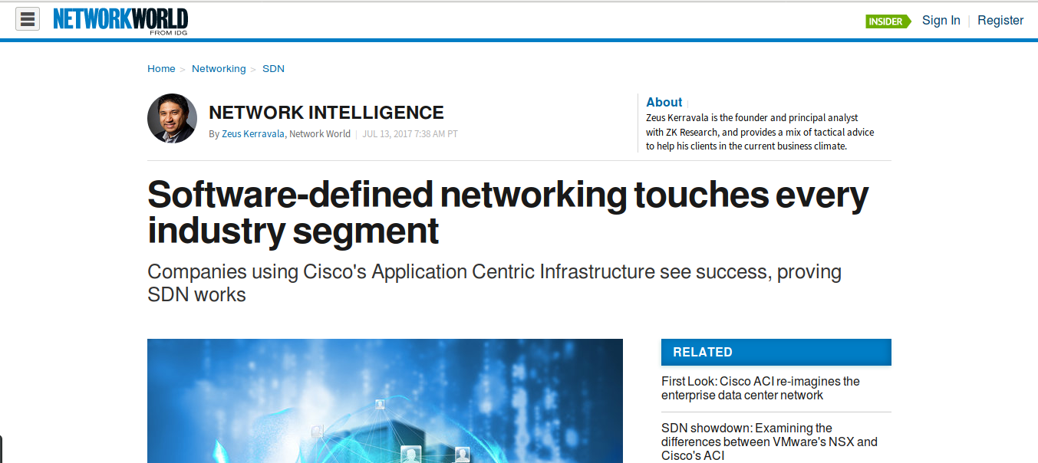



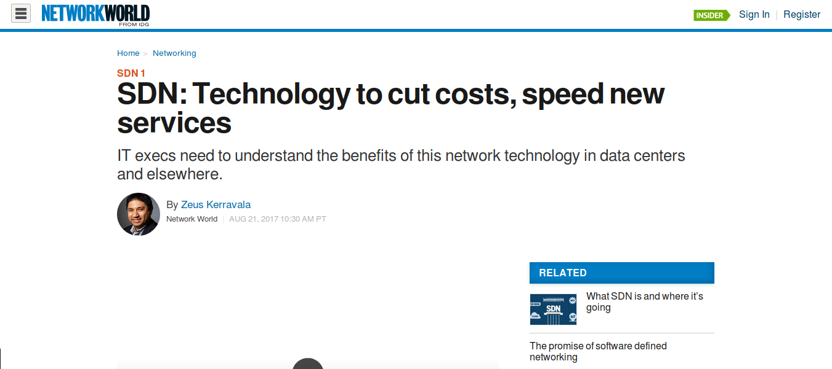

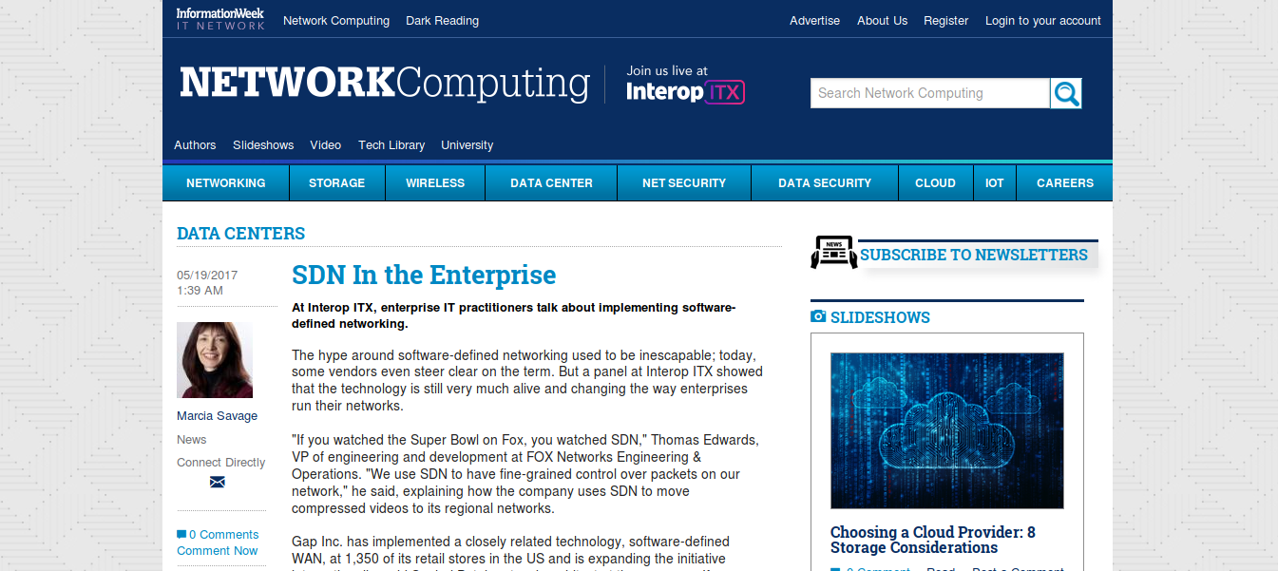



Software Defined Networking
Benefits:
Easier network management
Easier traffic engineering
Global view of network available
Per-flow control
  Security
  Performance
More agile and adaptive networks

Slide 3
SDN: Under the Hood
SDN switches
  Forward traffic based on flow rules in a table
  Send unmatched traffic to controller
SDN controller
  Contains network control logic
  Routing, ACLs, traffic engineering
  Usually does topology detection via LLDP
  Usually detects hosts via ARP
  Often allows pluggable apps to expand functionality
Standardized communication protocol
  OpenFlow
  Configuration protocol: specifies how to communicate, but not what commands to send
Traffic Engineering
ACLs
SDN Controller
Host
Tracking
Routing
Topology
Detection
Control
Plane
ARP
OpenFlow
LLDP
LLDP
Flow Rule
Switch
Switch
Switch
Data
Plane
Switch
Device
Device
Flow Table

Slide 4
SDNs are Incredibly Complex Systems
Complex requirements
  Essentially a re-implementation of decades worth of network technology
  L2 switching, Routing, Traffic Engineering
  Protocol Parsing, ProxyARP, multicast
  Topology discovery, Firewalling
  Current SDN controllers run into the millions of lines of code
Dynamic edge
  Network edge no longer manually defined, but dynamically discovered
  Filtering at the edge is no longer sufficient for security
Distributed systems
  Switches distributed throughout the whole network
  SDN controllers are often distributed for fault-tolerance and scalability
  Edge-cases are notoriously difficult to reason about

Slide 5

Numerous SDN Attacks
Host Location Hijacking [NDSS 2015]
  Attacker hijacks traffic to a victim host by sending spoofed traffic
  SDN controller believes victim has moved
Topology Poisoning [NDSS 2015]
  Attacker(s) spoof or redirect LLDP messages used to identify network links
  Can add or remove links in topology
ARP Poisoning [NDSS 2015]
  SDN controllers are vulnerable to ARP Poisoning attacks
Control Plane Saturation [CCS 2013]
  Overload controllers with more traffic than they can handle
  DoS on the network
Persona Hijacking [USENIX 2017]
  SDN controllers are vulnerable to powerful identity binding attacks
TE
ACLs
SDN Controller
LLDP
LLDP
Switch
Switch
Switch
LLDP
Switch
Device
Device

Slide 6
Addressing these Attacks
Ignore them and do nothing
  Attacks are never or slowly addressed; no attempt to prevent new attacks
Flow Rule Verification
  Verify that network invariants are maintained
  VeriFlow [SIGCOMM 2012], HSA [NSDI 2012], NetPlumber [NSDI 2013]
Hardened Controllers
  Controllers with improved isolation and security goals
  Rosemary [CCS 2014], SE-Floodlight [NDSS 2015]
Special Languages for SDN
  Write SDNs using languages that are secure and verifiable by design
  Frenetic [SIGPLAN 2011], NetKat [SIGPLAN 2014]
Testing frameworks
  Testing systems to find bugs and vulnerabilities
  OFTest [2016], Florence [2016], DELTA [NDSS 2017]
Not an acceptable solution
Attacks are not restricted to flow rules, difficult to meet realtime constraints
Even hardened controllers do not protect against all attacks (e.g. Persona Hijacking)
Difficult to use
Testing so far has focused on manually written tests for conformance and blind fuzzing

Slide 7
Our Approach
BEADS
Tests whole SDN systems, including unmodified SDN controllers and switches
Simulates malicious switches and hosts
Uses message modification and spoofed packets
Automatically generates thousands of possible strategies to test
Leverages message grammar and protocol semantics for efficient and systematic testing
Finds bugs causing error messages, network topology changes, reachability changes, or increased switch/controller load
Found 28 categories of bugs, 10 of which are new
  4 SDN controllers

Slide 8

Outline
Motivation
Background
  OpenFlow and ARP
Design and Implementation
Evaluation
Summary

Slide 9


OpenFlow
Controllers send commands and queries to switches
  Add/Remove/Modify flow rules and ports
  Send or request packets
  Query statistics
Switches send notifications to controllers
  Unknown or requested packets (packet_in)
  Switch port up/down events
6 different versions to date: 1.0-1.5
  Significant expansion of capabilities
  Most controllers use only very basic features
Complex message format
  Embedded data structures (e.g. port statistics)
  Data structures with embedded Type-Length-Value options
  2,051 possible fields in version 1.5
pkt
pkt
Statistics
Flow Rule
pkt
query

Slide 10


ARP
Data-plane protocol used to bind IP addresses to MAC addresses
Hosts broadcast queries for the MAC associated with an IP address
The owner of that IP address replies with its MAC address
SDN controllers use ARP to:
  Learn location of hosts, which will be used later in routing
  Maintain a single ARP cache for whole network to avoid expensive broadcasts
    ProxyARP
WHO HAS 10.0.1.42?
I do

Slide 11
BEADS: Goals
Test multiple real implementations
  Use virtualization to enable testing arbitrary controllers
  Use a proxy to simulate malicious switches by modifying messages
Test complete SDN systems
  Switches AND controllers AND hosts
  Use Mininet to emulate a full SDN network
  Hosts run special applications that can inject malicious packets
Use meaningful test cases
  Test more than just message parsers
  The interesting network control logic is buried deep in the controllers and is not a part of OpenFlow or ARP
Automatically generate test cases
  Manual test writing does not scale

Slide 12
BEADS Design
Message
Formats
Coordinator
Manager
Network
Topology
VM0
VM1
VMn
Bug
Reports
…
HostController
SDN
Controller 1
SDN
Controller n
Mininet
SW
Malicious Switch Proxy
SW
SW
Host
Host
Host
Host
Coordinator
  Generates test strategies based on message grammar and protocol semantics
  Controls multiple Managers
  Logs bugs
Traffic
Traffic
Traffic
Traffic
Mal. Host
Attack
Mal. Host
Attack
Mal. Host
Attack
Mal. Host
Attack

Slide 13
BEADS Design
Message
Formats
Coordinator
Manager
Network
Topology
VM0
VM1
VMn
Bug
Reports
…
HostController
SDN
Controller 1
SDN
Controller n
Mininet
SW
Malicious Switch Proxy
SW
SW
Host
Host
Host
Host
Manager
  Controls test case execution
  Emulated SDN network running in VM
  SDN controllers running in VMs
  OpenFlow proxy applies malicious actions
  Detection and reporting of bugs
Traffic
Traffic
Traffic
Traffic
Mal. Host
Attack
Mal. Host
Attack
Mal. Host
Attack
Mal. Host
Attack

Slide 14


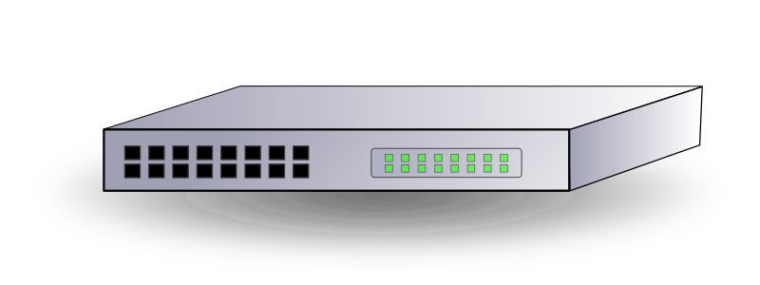
Test Cases: Malicious Switches
Send-message-based attack injection
  Proxy intercepts each message and modifies it based on the message type
Modify all messages of a single message type at a time
Collect all message types used by the controller or switch in a benign test
Apply message delivery and content modification actions to these message types
  Drop/Duplicate/Delay messages
  Change field X to value Y
  Use a small set of values for each field
  Based on the range of possible values and the purpose of the field
  Semantic awareness

Slide 15
Test Cases: Malicious Hosts
Time-based attack injection
  Inject new messages starting at a specific time and interval during the test
Generate spoofed ARP messages
  Appear to be from the victim host
  Containing configurable IP addresses and MAC addresses
Generate multiple strategies with different victim, attacker, and timing
  Can synchronize with malicious switch strategies if desired

Slide 16
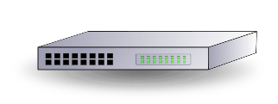
Anatomy of a Test
Test Manager requests new strategy from the Coordinator
SDN controller, malicious proxy, and Mininet are started
  Proxy and hosts are configured with malicious actions based on the strategy
SDN switches connect to controller via proxy
  Proxy sees all OpenFlow messages and can manipulate them
  This initial connection triggers a sequence of OpenFlow messages to configure the switches and begin topology discovery
Malicious Actions
Malicious Actions
Flow Rules
Topo Discov
Malicious Actions
Topo Discov
Proxy
Switch Info

Slide 17
Anatomy of a Test
Network topology Stabilizes
  OpenFlow messages for topology discovery are exchanged
Pairwise pings between all hosts are performed to check reachability
  Significant OpenFlow and ARP traffic as hosts talk to each other for the first time
Mininet, malicious proxy, and controller are stopped
Data from the test is evaluated to determine if a bug was found
Test results sent to Coordinator
Performance
Flow Rules
Flow Rules
Reachability
Unknown pkts
Proxy
Network State
Unknown ptks

Slide 18
Identifying Bugs
OpenFlow Error Messages
  Indicate invalid or unsupported OpenFlow commands
Network State
  The flow rules installed in OpenFlow switches
  Different network state indicates unexpected network behavior---a bug
Reachability
  Use Pair-wise pings between all hosts to verify network reachability
  If reachability is not as expected, a bug exists
Resource Usage
  Monitor the CPU and memory usage of the controller and switches
  Excessive usage indicates the possibility of resource exhaustion bugs
Resource
Usage
Error Messages
Flow
Rules
Reachability

Slide 19
Evaluation
Controller | Strategies Tested | Bugs Found
ONOS 1.2.1 | 6,996 | 578
POX (eel) | 4,286 | 478
Ryu 3.27 | 3,228 | 251
Floodlight 1.2 | 4,330 | 577
Total | 18,840 | 1,893
Network Topology:
4 host, 3 switch tree network
Testing time for each controller:
About 200 hours of computation, parallelized across 6 test managers
Found 1,893 buggy strategies in 28 categories, 10 of which are new

Slide 20

Example: Unexpected Flow Rule Removal
Malicious switch can convince ONOS to remove active Flow Rule
R2
Insert Rule
R1 (pkt=10)
Malicious switch modifies the packet count for the rule in returned statistics messages
ONOS believes rule is idle
ONOS explicitly deletes flow rule
Impacts:
  Dropped packets and degraded performance
  Increased controller load
This is much harder to identify than if the switch removed or ignored the rule
  Logs will indicate that ONOS is to blame
10 seconds
R2 (pkt=90)
Get Stats
R1 (pkt=40)
R2 (pkt=91)
Stats (pkt=0)
R1 (pkt=40)
No pkts matched, rule is idle. Remove it.
Delete Rule
R1 (pkt=50)
BEADS does not find fully weaponized attacks. However, the bugs it finds can be used by talented attackers to build powerful attacks

Slide 21


Attack Demonstration: Web Server Impersonation
Victims
Attacker can impersonate a target web server by confusing controller
Target
Target=Target
Attacker controls a host and a switch
Attacker uses an ARP poisoning bug to confuse controller about target web server’s location
Attacker uses a data-plane packet dropping bug to prevent target webserver from correcting its location
Attacker’s host pretends to be the target webserver to unsuspecting victims
Attacker
Victims
Malicious ARP
Malicious ARP
Target=Attacker
Target
Attacker
Victims
DP-bug
X
ARP
Target=Attacker
Target

Slide 22
Attack Demonstration: Deniable Denial of Service
Controller disconnects from malicious switch at apparently random and non-deterministic intervals
Bug
Buggy Rule
Sometime later
During connection handshake, malicious switch sends a buggy message
This sets up a periodic switch disconnect bug that will be triggered by the next ARP flood
Causes switch to disconnect for ~3 sec
  Disrupting topology
Very difficult to link back to attacker
  Logs will indicate that controller disconnected from switch
ARP
ARP Flood
ARP
X

Slide 23
Summary
We developed a framework, BEADS, to automatically identify bugs in whole SDN systems (controllers and switches) by simulating malicious switches with an OpenFlow proxy and malicious hosts using spoofed ARP packets
BEADS is applicable to a wide variety of controllers and switches and can quickly generate thousands of testing strategies based on message-grammar and protocol semantics. It is capable of finding bugs involving OpenFlow error messages, network topology changes, reachability changes, and excessive switch or controller load
We applied BEADS to 4 popular SDN controllers and found 28 categories of bugs, of which 10 are new
To underscore the importance of these bugs, we then demonstrated how they can be weaponized into 4 powerful attacks compromising key network goals
BEADS is Open Source. Check out the code at:
https://github.com/samueljero/BEADS

Slide 24
Questions?
Samuel Jero
sjero@sjero.net
Check out the code at:
https://github.com/samueljero/BEADS
Notes:
Q&A

