Slide 1



Automated Attack Discovery in TCP Congestion Control using a Model-guided Approach
Samuel Jero¹, Endadul Hoque², David Choffnes³, Alan Mislove³, and Cristina Nita-Rotaru³
¹Purdue University, ²Florida International University, and
³Northeastern University
NDSS 2018

Slide 2





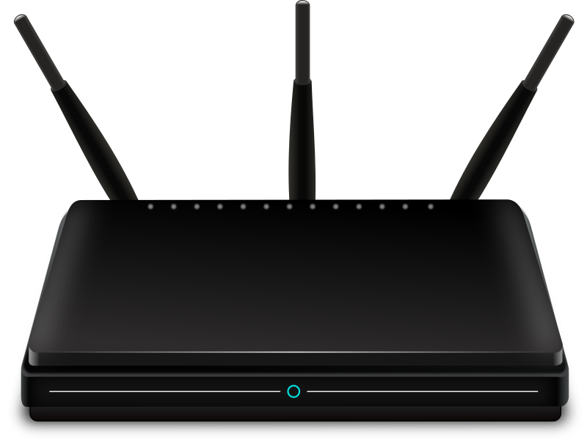



A Day In the Life of the Internet
TLS
TCP

Slide 3

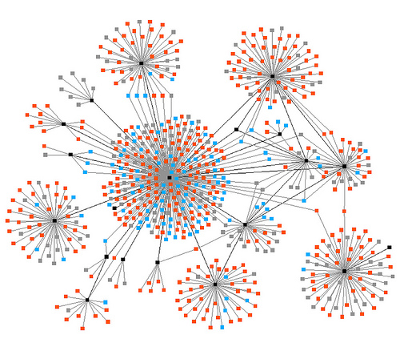









TCP
Transport protocol used by vast majority of Internet traffic
  Including traffic encrypted with TLS
  Including network infrastructure protocols like BGP
Thousands of implementations
  Over 5,000 implementation variants detectable by nmap
Provides:
  Reliability
  In-order delivery
  Flow control
  Congestion control

Slide 4
TCP Congestion Control
Protects against congestion collapse
  Majority of sent data is dropped later on
  Caused throughout decrease of 1000x in 1988
Also ensures fairness between competing flows
  Prevents one flow from starving others
Flow 1
Flow 1
Congestion
Collapse
Flow 2
Throughput
Flow 2
Throughput
Throughput
Starvation
Time
Time
Offered Load
Congestion Control is Crucial for Modern Networks
General scheme
  Additive Increase, probing for more bandwidth
  Loss indicates congestion
  Multiplicative Decrease, slowing down to clear congestion
Loss
Loss
Throughput
Time

Slide 5

Long History of Powerful Attacks
Optimistic Ack Attack (again)
Dup Ack Spoofing Attack
Blind throughput-reduction
Blind Flooding Attack
Desync Attack
Optimistic Ack Attack
Induced-Shrew Attack
Ack Division Attack
Shrew Attack
Ack Storm Attack
1995
2000
2005
2010
2015
Attacks may result in:
Decreased throughput
Increased throughput that starves competing flows
Stalled data transfer
X

Slide 6
Why So Many Attacks?
Attacks leverage designed behavior
  Congestion control is designed to control throughput
  Attacks confuse congestion control about network conditions
  No crashes or unusual control flow
Many designs and implementations
  Multiple Variations: Reno, New Reno, SACK, Vegas, BBR
  Multiple Optimizations: PRR, TLP, DSACK, FRTO, RACK
  Hundreds of implementations
Lack of unified specifications
  Individual components and optimizations are specified separately
  Understanding unified behavior is difficult
Very dynamic behavior
  Congestion control state changes with every acknowledgement
  Impact of individual packet dilutes quickly with time
OK, continuing to send
Network is full, slow down
Network is great, keep sending
RFC 2861
RFC 793
RFC 7323
RFC 5681
RFC 5827
RFC 3390
RFC 2581
RFC 3465
RFC 6937
RFC 2001
RFC 2018
RFC 3708
RFC 6298
RFC 3042
RFC 6582
RFC 6675
RFC 4653
RFC 2883
RFC 4015
RFC 5682
RFC 6528

Slide 7
Current Testing Methods
Manual Investigation
  Security researchers manually investigate possible attacks
Regression Testing
  Manually create tests for known attacks
  Test each implementation for vulnerability
MAX [SIGCOMM’11]
  Automatically finds manipulation attacks on network protocols
  Leverages symbolic execution to identify manipulations
SNAKE [DSN’15]
  Automatically fuzzes transport protocols searching for availability and performance attacks
  Uses state-machine attack injection for scalability
Labor Intensive, requires human to enumerate all possible attacks, does not scale
Unable to find new vulnerabilities, different implementations may not be vulnerable in the same way
Requires source code in a particular language and manual annotations
Does not scale to highly dynamic systems and complex attacks with many steps

Slide 8
Our Approach: TCPwn
Goal: Automatically test TCP implementations for attacks on Congestion Control
Test real, unmodified implementations
Scalability was the major challenge: attacks are complex and multi-stage, system is highly dynamic
Model TCP congestion control as a state machine
Use model-based testing to identify all possible attacks in a scalable manner
Create testable attacks using packet manipulation and injection
Finds attacks causing:
  Decreased Throughput
  Increased Throughput
  A connection stall
SS
CA
EB
FR

Slide 9
Optimistic Ack Attack
Increase sending rate by acknowledging data that has not been received yet
New Reno Congestion Control
State Machine
New Ack
--
cwnd+=1
New Ack
--
cwnd+=MSS
  Acknowledging new data causes green transitions to be taken
  Increases cwnd and thus throughput with each loop
  Avoids red transitions which reduce cwnd and thus throughput
cwnd > ssthresh
Slow
Start
Congestion
Avoidance
Timeout
Timeout
Timeout
Ack
--
cwnd=0
Exponential
Backoff
Ack above highest sent at loss
Key Takeaways:
Attacks attempt to cause desirable transitions
Attacks must repeatedly execute transition to have noticeable impact
Timeout
Fast
Recovery
3 Duplicate Acks
--
cwnd = cwnd/2
3 Duplicate Acks
--
cwnd = cwnd/2
Ack
--
cwnd+=1

Slide 10
Model-based Attack Generation
Generate all cycles with the following pattern:
  cwnd increases/decreases along cycle
  A set of actions exist that force TCP to follow this cycle
Consider state machine model of congestion control
Identify cycles containing desirable transitions
    Abstract strategy generation
Force TCP to follow each cycle
    Concrete strategy generation
State Machine
Abstract Strategies
Concrete Strategies
1
2
1,2,1…
1,2,3,1…
Delay Msg1, Drop Msg2
Drop Msg3, Dup Msg4
3

Slide 11

Abstract Strategy Generation
Enumerate all paths
  No standard graph algorithm
  We adapt depth first search to this problem
Check that path contains cycle
Check that cycle contains desirable transitions
  Any change to cwnd
Add path and transition conditions to abstract strategies
1
2
3
4
5
Cycle
Abstract strategies are merely desirable cycles; they may not be realizable in practice!
Desirable Transition
Notes:
“unvisit” each node after visiting the subtree rooted at it, allowing a different path to explore this subtree again

Slide 12

From Abstract to Concrete Strategies
We want to test implementations
Limited to packet manipulation and injection to cause abstract strategies
Consider each abstract strategy separately
Map each transition to a set of basic malicious actions
  Actions chosen to cause transition
  Based on attacker capabilities
Attacker Types:
On-path:
Off-path:
Abstract Strategy
State 1
State 2
Inject Dup Ack
Inject Pre Ack
Inject Offset Ack
Duplicate Ack
Limit Ack
Pre Ack
State1:InjectDupAck,State2:DuplicateAck
State1:InjectPreAck,State2:LimitAck
State1:InjectOffsetAck,State2:PreAck
State1:InjectDupAck,State2:DuplicateAcl
…
1
2
3
ACK && Dup
ACK && New

Slide 13
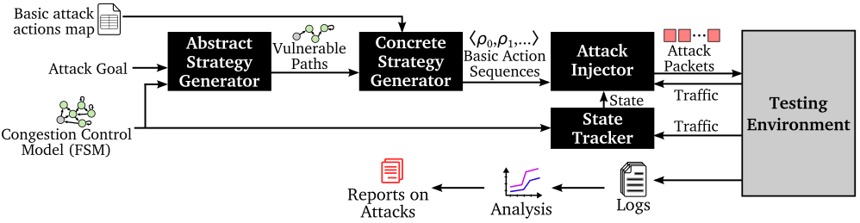
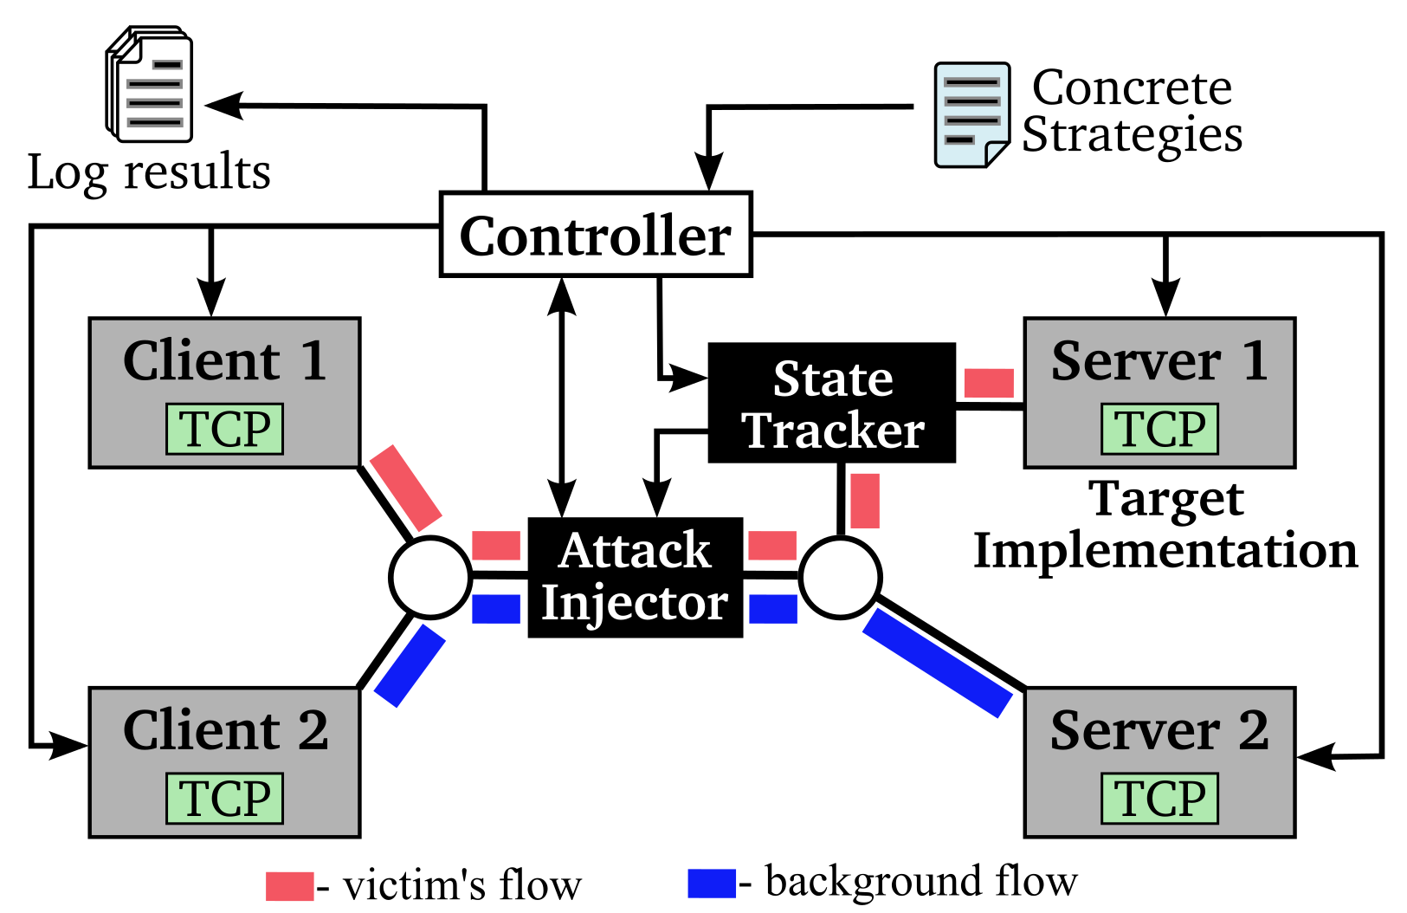
TCPwn Design
Test strategies creating using model-based testing and our abstract and concrete strategy generators
Testing done with virtual machines running real implementations in a dumbbell testbed network
Attack Injector applies malicious actions
Performance of target TCP connection identifies attacks

Slide 14
Evaluation
We tested five TCP implementations:
Implementation | Date | Congestion Control
Ubuntu 16.10 (Linux 4.8) | 2016 | CUBIC+SACK+FRTO+ER+PRR+TLP
Ubuntu 14.04 (Linux 3.13) | 2014 | CUBIC+SACK+FRTO+ER+PRR+TLP
Ubuntu 11.10 (Linux 3.0) | 2011 | CUBIC+SACK+FRTO
Debian 2 (Linux 2.0) | 1998 | New Reno
Windows 8.1 | 2014 | Compound TCP + SACK
Found 11 classes of attacks, 8 of them unknown

Slide 15
Results Summary
Attack Class | Attacker | Impact | OS | New?
Optimistic Ack | On-path | Increased Throughput | ALL | No
On-path Repeated Slow Start | On-path | Increased Throughput | Ubuntu 11.10, Ubuntu 16.10 | Yes
Amplified Bursts | On-path | Increased Throughput | Ubuntu 11.10 | Yes
Desync Attack | Off-path | Connection Stall | ALL | No
Ack Storm Attack | Off-path | Connection Stall | Debian 2, Windows 8.1 | No
Ack Lost Data | Off-path | Connection Stall | ALL | Yes
Slow Injected Acks | Off-path | Decreased Throughput | Ubuntu 11.10 | Yes
Sawtooth Ack | Off-path | Decreased Throughput | Ubuntu 11.10, Ubuntu 14.04, Ubuntu 16.10, Windows 8.1 | Yes
Dup Ack Injection | Off-path | Decreased Throughput | Debian 2, Windows 8.1 | Yes
Ack Amplification | Off-path | Increased Throughput | Ubuntu 11.10, Ubuntu 14.04, Ubuntu 16.10, Windows 8.1 | Yes
Off-path Repeated Slow Start | Off-path | Increased Throughput | Ubuntu 11.10 | Yes

Slide 16
Summary
We developed a new, model-guided technique to search for possible attacks on TCP congestion control. This technique uses the congestion control state machine to generate abstract strategies which are then converted into concrete strategies made up of message-based actions
We implemented this technique in TCPwn, which is able to find attacks on real, unmodified implementations of TCP congestion control
We tested 5 TCP implementations and found 11 classes of attacks, 8 of which were previously unknown
Check out the code!
https://github.com/samueljero/TCPwn

Slide 17
Questions?
Samuel Jero
sjero@sjero.net
Check out the code!
https://github.com/samueljero/TCPwn
Notes:
Q&A

Slide 18
Off-path Repeated Slow Start Attack
Linux includes adjustable dup ack threshold
  Based on observed duplicate and reordered packets
Attacker injects many duplicate acks
  Increasing dup ack threshold
Timeout occurs before dup ack loss detection
Enter Exponential Backoff and then Slow Start
  Instead of Fast Recovery
Short 200ms timeout causes throughput to be >= normal
Competing connections also suffer badly due to repeated losses
Off-path attacker can increase throughput for Linux senders
Dup Acks
Sending
Rate
RTO
RTO
RTO
RTO
RTO
RTO
RTO
Time

Slide 19
Inferring Congestion Control State
To apply concrete strategies to an implementation, we need to know the sender’s congestion control state
Approximate congestion control state and assume normal application behavior
Take a small timeslice and observe the bytes sent and acknowledged by the implementation
Bytes Sent*2 ≈ Bytes Acked
  State: Slow Start
Bytes Sent ≈ Bytes Acked
  State: Congestion Avoidance
Retransmitted packets or ACK pkts > Data pkts
  State: Fast Recovery
ACK pkts == 0 and Data pkts > 0
  State: Exponential Backoff
Slow Start
Data
Ack
Fast
Recovery
Sequence Number
Congestion Avoidance
Time

Slide 20
More on Congestion Control
Model as a state machine
  Input: Acks and Timers
  Output: Congestion Window (cwnd)
Four states:
  Slow Start—Quickly find available bandwidth
  Congestion Avoidance—Steady state sending with occasional probe for more bandwidth
  Fast Recovery—React to loss by slowing down
  Exponential Backoff—Timeout, slow down
New Reno Congestion Control
State Machine
New Ack
--
cwnd+=1
New Ack
--
cwnd+=MSS
cwnd > ssthresh
=sending rate
Slow
Start
Congestion
Avoidance
Timeout
Timeout
Timeout
Ack
--
cwnd=0
Exponential
Backoff
Ack above highest sent at loss
Timeout
Fast
Recovery
3 Duplicate Acks
--
cwnd = cwnd/2
3 Duplicate Acks
--
cwnd = cwnd/2
Ack
--
cwnd+=1

Slide 21
Limitations
Use of New Reno as model
  Model limited by ability to infer sender’s state from network traffic
  More precise inference or instrumentation would enable more precise modeling
  We trade off precision for ease of application to a wide range of implementations
What about CUBIC, SACK, etc?
  Most algorithms/optimizations are similar to New Reno
    This includes: SACK, CUBIC, TLP, PRR
  We actually tested implementations of these and found attacks
What about algorithms not similar to New Reno?
  For example: BBR, TFRC, Vegas
  Model-based testing still readily generates abstract strategies
  Need a method to infer sender’s congestion control state
SS
CA
EB
FR

