Slide 1



More than a Fair Share:
Network Data Remanence Attacks against Secret Sharing-based Schemes
Leila Rashidi, Daniel Kostecki, Alexander James, Anthony Peterson, Majid Ghaderi, Samuel Jero, Cristina Nita-Rotaru, Hamed Okhravi, Reihaneh Safavi-Naini

Slide 2



Secure Communication
Hello!
Hi
Establish a secure and authenticated communication channel using standard protocols such as TLS or QUIC
Security guaranteed by cryptographic primitives that assume computationally-bounded adversary
This Photo by Unknown Author is licensed under CC BY-NC
Notes:
Relies on many assumption, the one we focus on is

Slide 3
… disrupted by Quantum Computing
Emergence of quantum computing breaks assumptions needed for the security of existing cryptographic primitives
Design secure communication without relying on computational assumptions about the adversary
Existing approaches
  Information theory
    Secret sharing
  Computer networks
    Multi-path routing
    Path switching

Slide 4
Secret Sharing
A. Shamir. How to Share a Secret. 1979
How to split and recreate a secret between participants n that do not trust each other
A (k, n) scheme:
  Divide a secret S into n pieces s₁, . . . s_{n}
  Any group of k or more users can jointly obtain the secret
  Any group of k-1 or less users can not jointly obtain any information about the secret;
Security: Secure as long as the adversary does not capture more than k-1 shares

Slide 5
Secret Sharing and Multi-path Routing
M split with( k,n)
The message remains perfectly secret as long as the adversary can access at most k − 1 paths
Adversary bounded in terms of network access; does not know/observe ALL the paths

Slide 6
Multi-path Switching with Secret Sharing (MSSS)
Path-switching: A random path is chosen for each message and used for transmission of the message
MSSS (k,n):
  Sender splits the message in k shares
  Sender sends the shares on k disjoint paths
  Sender and receiver switch to a randomly selected set of paths out of the total set of n paths
It provides information-theoretic security against an adversary with access to a quantum computer
R. Safavi-Naini, A. Poostindouz, and V. Lisy, “Path hopping: An MTD strategy for quantum-safe communication,” in ACM Workshop on Moving Target Defense, 2017

Slide 7
This talk
Examine if assumptions made by the theoretical models to prove security are met in real networks
Identify a side-channel (Network Data Remanence) and attacks exploiting it (NDR Blind and NDR Planned)
Propose countermeasures and demonstrate their effectiveness
Are practical implementations of multi-path switching with secret sharing schemes secure?

Slide 8
Multi-path Switching with Secret Sharing
System
Network:
There are n disjoint paths known by sender and receiver and connecting them
Attacker
Can not observe and access all paths
Each clock tick j
Selects set K_{j} = {k paths out of n}
Accesses K_{j} to recover shares
Switch clock can be the same or not with the one of the sender
Sender:
Each clock tick i:
Selects set K_{i} = {k paths our of n}
Splits M using (k,k) secret sharing
Sends them on the set of paths K_{i}
Receiver:
Listens to all paths; thus no need for secret key
Security
It provides information-theoretic security and remains secure against an adversary with access to a quantum computer

Slide 9
Model Used for Security Analysis
Model assumes that paths have same length and delay
Real networks:
Paths do not have the same number of hops
Links (and paths) do not have the same delay
Attacker gets more chances at capturing a share on a path
(than assumed by the model)

Slide 10
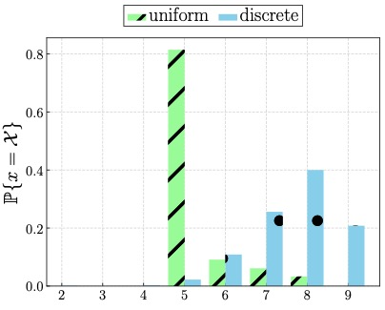
Network Data Remanence Side-Channel (NDR)
(5, 9) scheme, showing active paths – paths that have ongoing packets
NOT GOOD
Packets linger longer in the network creating a side-channel
Notes:
Each experiment consists of a single path switching flow between a source and destination node connected by N = 9 disjoint paths. The flow was a bulk data transfer of size 20 MB. The bulk data is divided into messages of size 256 B for transmission. The multi-path switching parameter K is set to 5 and the switching interval δ is set to to 100 ms. Two scenarios are considered where path delays are drawn uniformly from the range [0,250] ms and the set {0,100,200} ms. Each of the paths also incurred 50 ms of jitter meaning that the latency on an individual path could randomly vary by up to 50 ms for each packet transmitted over the path. These latency values were selected as we believe they represent a reasonable upper bound on the amount of latency experienced by typical Internet traffic.

Slide 11
Attacker Capability
Captures packets at nodes
  have access to all of the nodes, but they cannot possibly capture traffic from all of them at all times.
  can only capture traffic at a fraction of nodes at each time.
Able to listen to at most K nodes simultaneously (K is number of paths used by MSSS)
Can switch what paths they are listening to and at what intermediate nodes
Notes:
In a typical network attack, switches are compromised when they are vulnerable, maybe because a weak password was used or a software vulnerability is present in their implementation. Switches in an enterprise-level network often have rather homogeneous models, so we assume that the attacker has access to all switches and can redirect a copy of the traffic to their machine.

Slide 12
MSSS Attacks that Do Not Exploit NDR
Attacker switches nodes or not, does it know or not the time the sender switches paths
Fixed attacker: does not switch nodes
Independent attacker: switches nodes but does not know switching time
Synchronized attacker: switches nodes and knows switching time, i.e. it is synchronized with the sender

Slide 13
Network Data Remanence Attacks
NDR Blind: selects K nodes from all nodes on all paths
NDR Planned: follows shares as they travel along the paths in the network
  listens to K random nodes of distance 1 from the sender
  probes K random nodes of distance 2 from the sender during the second switching interval
  and so on ….
NDR Planned Opt: checks at each step to see if all shares needed to reconstruct a message are captured.
  Starts at distance 1, instead of continuing with next hop
Attacker strength

Slide 14
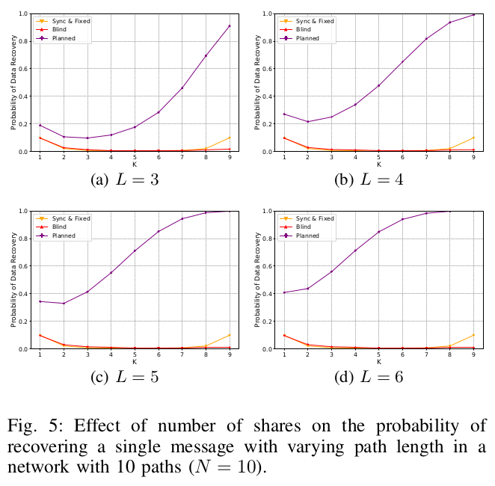
Probability of Data Recovery
L: path length
K: # shares
N: # paths, 10
NDR Planned attacker is very effective
NDR Blind is not very effective

Slide 15
MSSS SDN-based Design
UDP ports are used to distinguish between paths
Receiver listens to all paths

Slide 16
Experimental Results
Implemented with ONOS and Mininet
Vary path length and key shares
Model link delay
N = 10
L = 4
K = 3
Path switching δ = 100 ms
File size = 10MB
M = 512B
Notes:
Independent switching interval, δ = 200ms

Slide 17
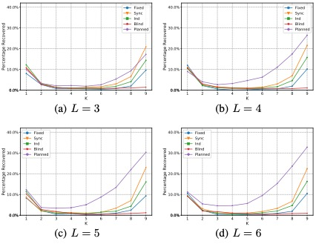
Impact of Path Delay
NDR Planned attacker is very effective in SDN –based implementation
Notes:
50 ms delay on each link, randomly sampled delay from the continuous interval [0 ms, 100 ms] is applied before the first node and a randomly sampled jitter from the continuous interval [0 μs, 100 μs] is applied on each share sent.

Slide 18
How to Mitigate the Attacks?
We want to keep information theoretic security
  Break the message into more shares
How to send these shares:
  Use more disjoint paths – need to also increase the attacker power to be fair
  Use the same K paths repeatedly -- could result in reduced protection
Our approach: distribute shares over both time and space instead of just space using a random set of paths to send a K-sized set of shares

Slide 19
Our Mitigation
Generate more shares and spread them across both space and time
Instead of (K, K), the sender uses (HK, HK) secret sharing
  divide the shares into H sets of K shares
  send these sets of shares, one at each consecutive clock tick
  at t = 0, 1, . . . , H − 1, the sender chooses K paths uniformly at random, and then sends a share along each chosen path
We call H resilience factor, a system parameter that can be configured by the sender

Slide 20
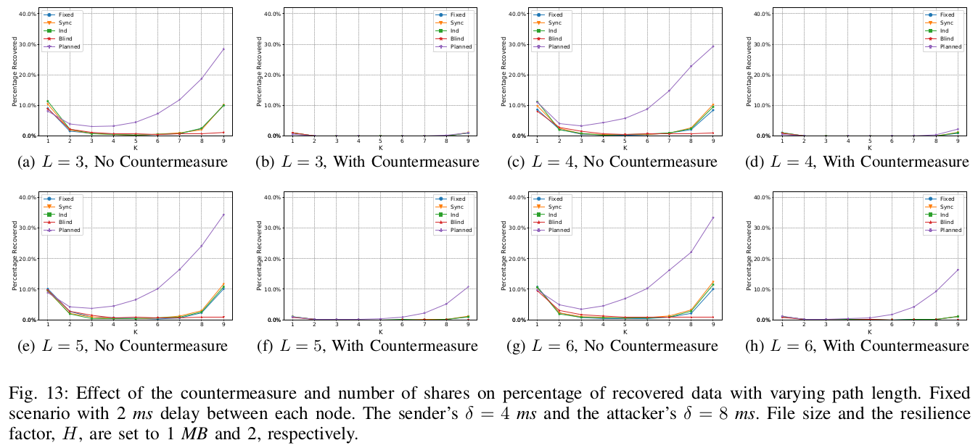
Experimental Results: Probability Data Recovery
Countermeasure mitigates the NDR Planned attack in SDN-based implementation

Slide 21
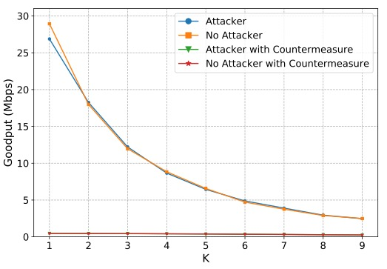
Experimental Results: Goodput
L = 3, H = 2, sender’s δ = 4 ms, attacker’s δ = 8 ms.
Increasing the number of shares, and spreading them through time, has a significant impact on performance

Slide 22

Summary
Analyzed secure communication schemes that do not make computational assumptions about the attacker
Identified a side-channel Network Data Remanence and analyzed and demonstrated attacks that exploit it in a SND-based implementation of MSSS
Proposed a countermeasure, analyzed and demonstrated in the same SDN-based implementation

