Slide 1
Porting NASA’s core Flight System to the Formally Verified seL4 Microkernel
Juliana Furgala, Samuel Jero, Andrea Lin, Richard Skowyra
SpaceSec 2026
23 February 2026
DISTRIBUTION STATEMENT A. Approved for public release. Distribution is unlimited. This material is based upon work supported under Air Force Contract No. FA8702-15-D-0001 or FA8702-25-D-B002. Any opinions, findings, conclusions or recommendations expressed in this material are those of the author(s) and do not necessarily reflect the views of the U.S. Air Force. © 2025 Massachusetts Institute of Technology. Delivered to the U.S. Government with Unlimited Rights, as defined in DFARS Part 252.227-7013 or 7014 (Feb 2014). Notwithstanding any copyright notice, U.S. Government rights in this work are defined by DFARS 252.227-7013 or DFARS 252.227-7014 as detailed above. Use of this work other than as specifically authorized by the U.S. Government may violate any copyrights that exist in this work.
Notes:
1
1
Good morning. My name is Samuel Jero and I’m a member of technical staff at MIT Lincoln Laboratory. Today I’m going to be presenting our paper “Porting NASA’s core Flight System to the Formally Verified seL4 Microkernel”. This is joint work with my colleagues Juliana Furgala, Andrea Lin, and Rick Skowyra.

Slide 2


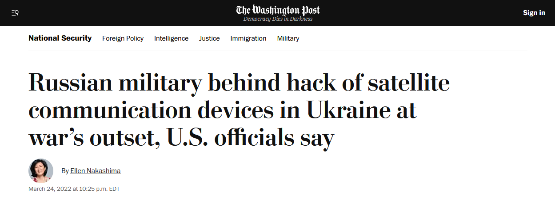
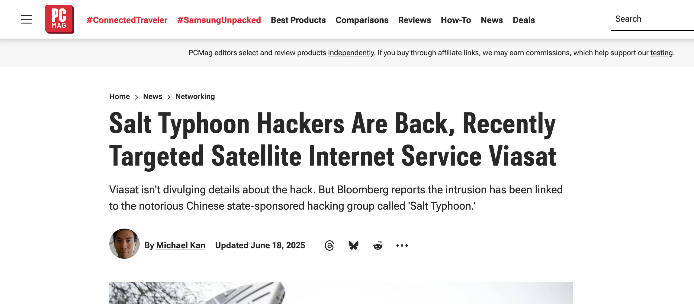
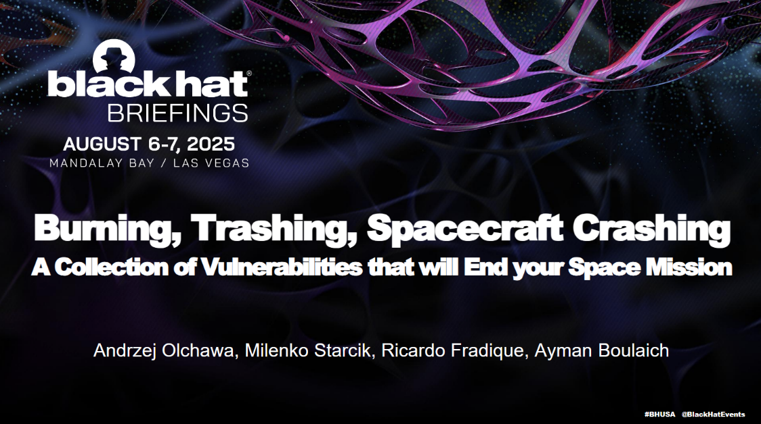
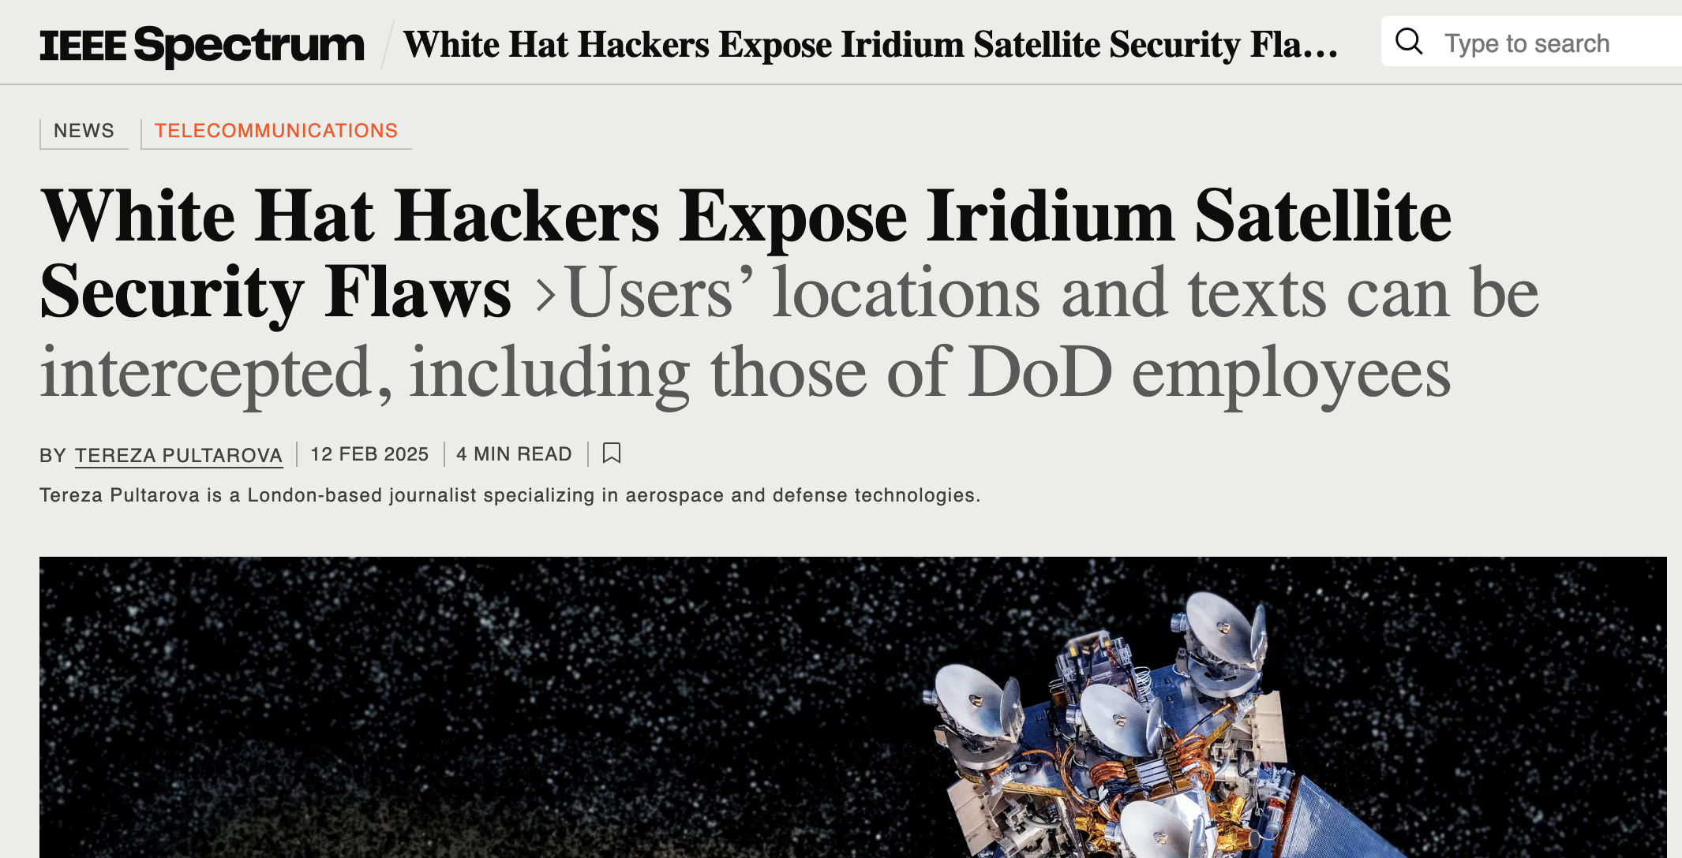

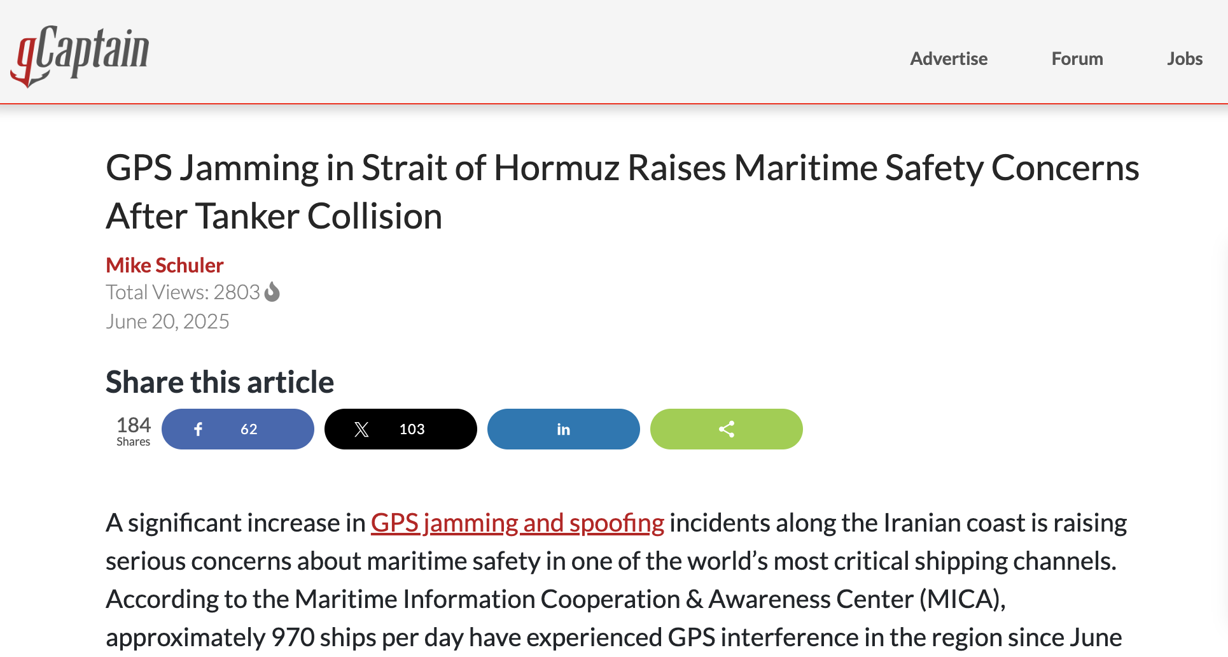



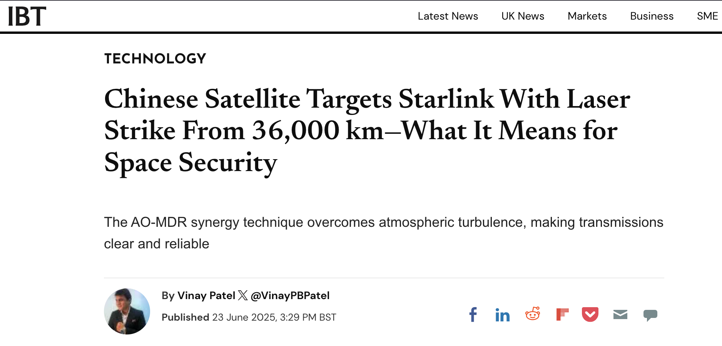





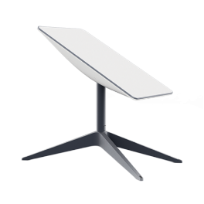
Satellite Systems are Valuable Targets
Communication
Satellite Internet
GPS
Weather
Notes:
We’re at a workshop on Satellite Security, so I probably don’t have to convince all of you that satellite systems are extremely important to the modern world. GPS alone has transformed the modern world, enabling position and navigation for so many systems and providing precise timing for many others. Satellite imaging has been similarly transformative, especially for weather forecasting. Satellites have made communication anywhere on the globe possible, from traditional Satellite Radios for use in areas where terrestrial infrastructure is non-existent or destroyed, to constellations providing Satellite Internet with responsive latency to rural areas.
Yet, probably because of the critical nature Satellites play in society, we are increasingly seeing these satellite systems come under attack. From Russia’s hack of the Viasat satellite network, immediately prior to their invasion of Ukraine, to massive GPS interference in active war zones, to targeting satellites with lasers and satellite providers with phishing attacks, we are seeing satellite systems increasingly targeted by attackers, often motivated, well-resourced, nation states. To counter these attacks, work on the security of these systems is clearly required.

Slide 3
Much Potentially Applicable Security Work
Safe Programming Languages
Isolation Techniques
SFI
TEEs
Rust
Sandboxes
Go
Tagged Architectures
SSCC
Containers
Fail-Safe C
Ada
CCured
Software Security Techniques
Microkernels
Formal Verification
HAKC
CFI
DEP
Verified Parsers
DFI
Shadow Stacks
CertiKOS
seL4
Stack Canaries
RustBelt
Push-button
verification
ASLR
How well do these existing Security Tools work for satellite systems?
SSCC: Safe Secure C/C++
CFI: Control Flow Integrity
DFI: Data Flow Integrity
ASLR: Address Space Layout Randomization
DEP: Data Execution Prevention
SFI: Software Fault Isolation
TEE: Trusted Execution Environment
HAKC: Hardware Assisted Kernel Compartmentalization
Notes:
Fortunately, the security community has spent the last several decades developing technologies to secure computer systems, many of which may be applicable to satellite systems. I’ve listed a few categories of these technologies on this slide. This includes safe programming languages like Rust, Go, and safe dialects of C that seek to make it easier to write correct software as well as software security techniques like Control Flow Integrity, Data Execution Prevention, and Stack Canaries that prevent the exploitation of common vulnerabilities. There are also isolation techniques that try to partition the system into components and ensure that faults and compromise doesn’t spread across components. These include Software Fault Isolation, Sandboxes, and Microkernels. Finally, formal verification seeks to formally reason about a software system and provide assurance about its correctness and other properties. Work has been done on formally verifying parsers, libraries, and microkernels, among other things.
It is unlikely that all of these techniques will be applicable or valuable for space systems and certainly space systems have unique challenges. However, we should carefully consider these existing technologies and see which of them might be valuable for space systems. I think that these last two categories: isolation techniques and formal verification are particularly applicable to space systems, due to their expense and difficulty of physical access once launched.

Slide 4
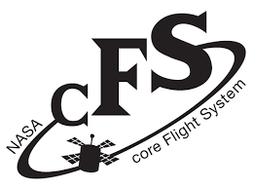

This Work
Report on our experience trying to use ONE of these existing security tools with real flight software
NASA’s Core Flight System (cFS)
The seL4 Formally Verified Microkernel
ON
One of the most common flight software systems for satellites
Used in dozens of missions
Gold standard for assured, correct software today
Machine-checked formal proofs of both source and binary correctness
Notes:
That takes us to this work, where we tried to actually integrate one of these existing security tools with real flight software. In particular, we attempted to port NASA’s Core Flight System, one of the most common flight software systems for satellites that has been used on dozens of missions, to the seL4 Formally verified microkernel. This is both a formally verified system, bringing with it this mathematical guarantee of correctness, but it is also a microkernel, whose job is to provide isolation to the rest of the system.

Slide 5

Outline
Motivation
Background
Porting cFS to seL4
Summary
Notes:
Okay, so far we’ve focused on the motivation for this work. We’re now going to cover some necessary background before diving into our experience trying to port cFS to seL4. Finally, we will wrap up with a short summary.

Slide 6
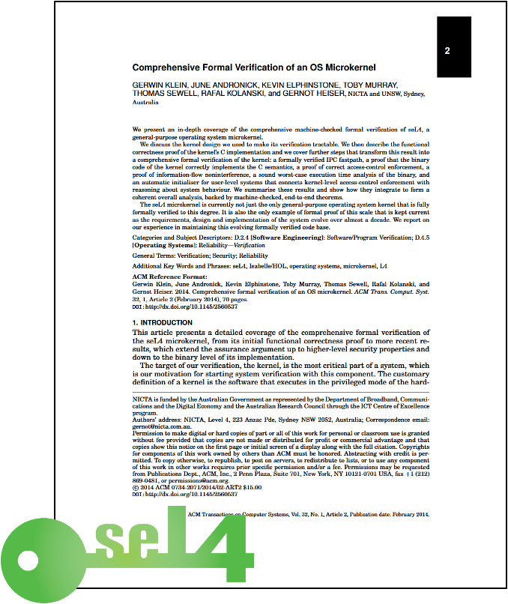





seL4
Formally verified microkernel
30-person years to verify
~9KLOC
Not a full operating system
Does not provide file systems, networking, device drivers, synchronization primitives, executable loading, etc
Only provides scheduling and isolation, and access control for those
0101
101010
1010
API
Functional Correctness
Free From Memory Bugs
Binary Correctness
Data Integrity
seL4 is the gold standard in correctness and assurance
Notes:
The first thing we need to talk about is seL4, which is this formally verified microkernel. Now, what formal verification means is that the authors took their source code and mapped it to a series of mathematical expressions. They then proved properties over those mathematical expressions. What properties did they prove? Well, they proved functional correctness, which means that the kernel correctly implements its specification and further that it doesn’t implement anything that is not in its specification. This proves the kernel free from a wide variety of bugs, including memory safety issues, kernel panics, and null pointer dereferences. They also proved binary correctness and data integrity, that there’s no way to bypass the microkernel and get access to its internal data structures.
No this was a major effort, taking some 30 person years to verify. However, seL4 is only about 9,000 lines of C code, with about as much functionality as you expected from 9,000 lines of C code. In particular, seL4 doesn’t provide most of things you expect in an operating system, like networking, filesystems, device drivers, or synchronization primitives. All it provides is scheduling and isolation and a method to control access to those things.

Slide 7
Benefits for Space Vehicles
Reduces operating system vulnerabilities
seL4 is proved to lack numerous classes of vulnerabilities
Key functionality like scheduling and memory isolation proved correct
Reduces impact of remaining vulnerabilities
Components may still have vulnerabilities
Impact of those is bounded by the isolation provided by seL4
One compromise no longer compromises entire system
seL4 has the potential to dramatically improve space vehicle security
Notes:
Okay, so what benefits does seL4 have for a space vehicle? There are two major ones. The first is that it reduces the number of operating system vulnerabilities. In particular, seL4 is proven to lack numerous classes of vulnerabilities. This is in sharp contrast to most existing operating systems used for space vehicles, like RTEMS, VxWorks, and Linux, all of which effectively exhibit a continuous stream of bugs and vulnerabilities. In addition, because the key functionality of seL4, like scheduling and isolation, is proven correct, there won’t be any functionality bugs either.
Second, seL4 dramatically reduces the impact of any remaining vulnerabilities in the system. This is because it separates the system into isolated components and, while those components may still have vulnerabilities, the goal is that seL4 bounds the impact of a compromise to one component. In this way, one compromise no longer compromises the entire system.
Overall then, seL4 has the potential to dramatically improve space vehicle security.

Slide 8
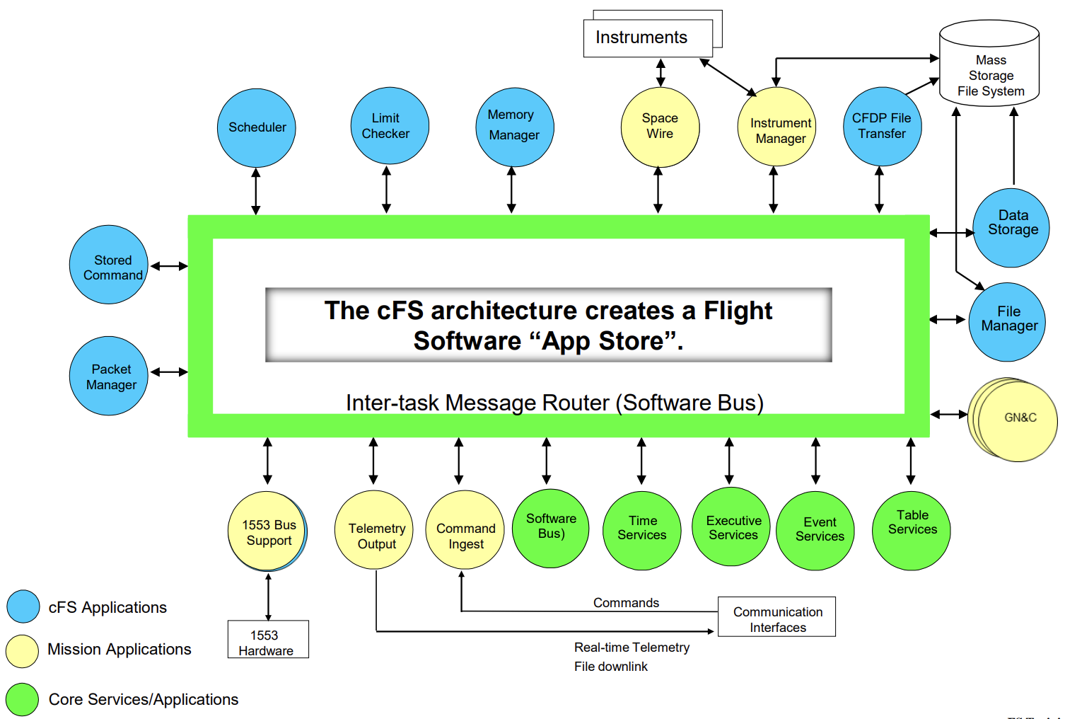
NASA’s core Flight System (cFS)
Widely used flight software framework developed at NASA Goddard
Possibly the dominate flight software system
Used extensively by more than 40 missions across multiple space agencies and academic institutions
Designed as an extensible framework
Different components are pluggable “apps”
Publish/Subscribe bus to communicate between “apps”
Collection of reusable “apps” for common mission needs
Broad hardware and platform support
Enabled by an OS Abstraction Layer (OSAL)
Open source
cFS is an ideal candidate for understanding the utility of seL4 for space systems
Notes:
The other thing we need to discuss is NASA’s core Flight System or cFS. cFS is a widely used flight software framework developed by NASA Goddard. It is quite possibly the dominate flight software framework used on space missions, although that is difficult to measure. What we can say is that it has been used extensively by more than 40 missions across multiple space agencies and academic institutions for the last 20 years.
Its designed as an extensible framework, where components are pluggable “apps” that communicate over a pub/sub bus, and cFS provides a collection of reusable apps for common mission needs. Further, cFS is open source and has broad hardware and platform support. This is enabled by an Operating System Abstraction Layer or OSAL where cFS abstracts its required OS functionality and then all each OS has to do is implement that abstraction.
All of this makes cFS the ideal candidate for testing the utility of something like seL4 for space systems.

Slide 9
Outline
Motivation
Background
Porting cFS to seL4
Summary
Notes:
Okay, now that we’ve covered the necessary background, we’re going to move on to our work actually porting cFS to seL4.

Slide 10
First Attempt
Leverage existing CAmKES system orchestrator
Standard in the seL4 ecosystem
Loads executables, sets up communication
Distributes seL4 capabilities
Assumes system is completely static
Leverage existing seL4 helper libraries
10’s of KLOC of unverified C code
Device drivers, memory management, etc
Use seL4 capabilities to create OSAL
Threading -> TCB capabilities
Semaphores/Mutexes -> Notification Objects
Timers -> Notification Objects + device driver
House Keeping
CI
TO
cFE
OSAL API
PSP API
seL4 Support
ZC702 Support
Unverified seL4 C libraries
CAmKES
seL4
Hardware (ZC702)
Leveraging existing work got us a long way, but there was a major issue…
Notes:
Our first attempt to port cFS to seL4 leveraged all of the existing tooling in the seL4 ecosystem. In particular, since seL4 doesn’t have the ability to load executables, seL4-based systems typically used CAMKES, which is similar to an init for seL4. It starts any executables in the system and sets up any communication between them as well as distributing seL4 objects, called capabilities. However, it assumes that the system is completely static and that all executables, communication patterns, and objects can be specified in its configuration file at compile time. Further, it requires the use of a bunch of existing seL4 helper libraries, which are tens of thousands of lines of unverified C code for things like device drivers and memory management.
With these as a foundation, actually creating the cFS OSAL is pretty straightforward. seL4 capabilities translate pretty smoothly to the required functionality. For instance, threading can be implemented using seL4 thread control block, or TCB, capabilities. Synchronization primitives can be implemented using seL4 notification object capabilities, and timers can be implemented with a notification object and a device driver.
Overall, leveraging this existing work got us a long way towards a functional port, but there were also significant issues.

Slide 11
Issue
Mismatch between cFS’ dynamic resource usage and CAmKES static resource allocation
CAmKES requires that all resources be specified up-front in a configuration file
cFS assumes that it can freely ask the OS for resources at any point and in any number
Work Around: Experimentally determine a reasonable upper bound
Not a good long-term, high-assurance solution
Payload App v1
Payload App v2
File Manager
Apps
CFDP
Executive Services
Time
We decided the solution was to build a new OS around seL4
Notes:
The largest of these issues was the mismatch between cFS’s dynamic resource usage and CAMKES static resource allocation. In particular, CAMKES requires that all resources in the system be specified up-front in a configuration file while cFS assumes that it can freely ask the OS for resources at any point and in any number. Now, its possible to experimentally make this work by picking an upper bound for the resources in the CAMKES configuration file and then trying to run cFS and seeing if it crashes. However, this is neither a good long term solution nor is it good for high assurance systems, like space vehicles.
The other issue with this approach was the amount of unverified C code we were introducing into the system. Recall that one of the major benefits of seL4 was its formal verification. Yet to use seL4, we needed to rely on all of this unverified C code.
Ultimately, these issues caused us to go back to square one, really square zero, and build an entirely new OS around seL4.

Slide 12
Magnetite
New OS written in Rust
Eliminates memory-safety vulnerabilities
Builds directly on seL4
Composed of Many System Services
Motivated by the principle of least privilege
Each services handles a particular type of functionality
Services are isolated, independent processes
Services support dynamic creation of resources
Needed seL4 capabilities are created dynamically
Supports the functionality required by cFS
App Thread 1
App Thread n
App Thread 1
App Thread n
C App
Rust App
App escrow process
App escrow process
Network service
Event service
Synchronization service
Channel service
Timer service
Ethernet service
Untyped service
Loader
Logging service
Root Task
SeL4
Magnetite uniquely enables dynamic systems on seL4
Notes:
This new OS is called Magnetite and is written entirely in Rust, to eliminate memory safety vulnerabilities. It also builds directly on top of seL4, without using CAMKES or other existing libraries. Magnetite is composed of a number of system services, each of which handles particular functionality, like networking, synchronization primitives, or timers. Each of these services are isolated, independent processes. Within each of these services, resources can be created dynamically by creating the appropriate seL4 objects dynamically. In this way it supports the functionality required by cFS.
Overall, this makes Magnetite a secure OS that uniquely enables dynamic systems on seL4.

Slide 13
Final Approach
Use Magnetite on top of seL4 to run cFS
Magnetite can start cFS
Magnetite services provide needed resources
Create new OSAL layer using Magnetite
Calls the appropriate system service to perform the relevant operation
Magnetite provides dynamic resources in the way cFS expects
Can simply ask Magnetite to create a new semaphore, etc
House Keeping
CI
TO
cFE
OSAL API
PSP API
Magnetite Support
ZC702 Support
Magnetite
seL4
Hardware (ZC702)
Magnetite provides a reliable way to run cFS on seL4
Notes:
That brings us to our final approach for porting cFS to seL4. We use Magnetite on top of seL4 to run cFS, such that Magnetite can start cFS and then the Magnetite services provide all needed resources. Our cFS Operating System Abstraction Layer then just calls the appropriate Magnetite system service to perform the relevant operations. And Magnetite is designed to provide the dynamic resources exactly how cFS expects them, so cFS can simply ask Magnetite for a new resource and Magnetite will create it.
This provides a reliable way to run cFS on seL4.

Slide 14
Summary
Satellite systems are increasingly targeted by adversaries but have historically lacked a focus on security
Decades of security research have produced significant work that could be beneficial to the space community
We tried to apply one of those security technologies to flight software: to run NASA’s cFS on seL4. The process of porting cFS to seL4 was complicated by the unexpectedly dynamic nature of cFS and similar flight software. This ultimately led us to develop a full OS called Magnetite, around seL4
Notes:
In summary, satellite systems are increasingly targeted by adversaries but have historically lacked a focus on security. However, there are decades of research by the security community that could be beneficial to the space community.
We tried to apply one of those security technologies to flight software: to run NASA’s cFS on seL4. This turned out to be unexpectedly complicated due to the dynamic nature of cFS and similar flight software and to the seL4 ecosystem assuming completely static behavior. This ultimately lead us to develop a full OS called Magnetite around seL4.

Slide 15
Questions?
Dr. Samuel Jero
samuel.jero@ll.mit.edu
Notes:
That concludes my presentation. I’d be happy to take any questions now.

